Slide 1
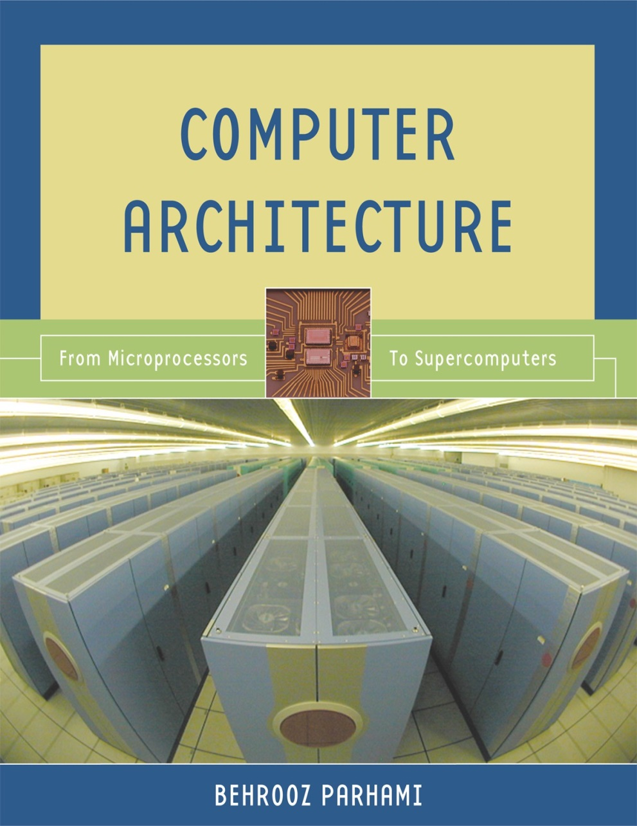
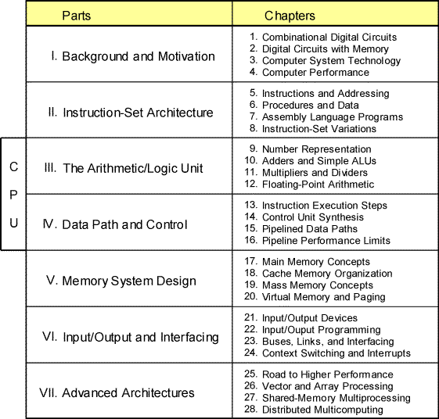
Part III
The Arithmetic/Logic Unit
Oct. 2014
Computer Architecture, The Arithmetic/Logic Unit
Slide <number>

Slide 2
About This Presentation
This presentation is intended to support the use of the textbook Computer Architecture: From Microprocessors to Supercomputers, Oxford University Press, 2005, ISBN 0-19-515455-X. It is updated regularly by the author as part of his teaching of the upper-division course ECE 154, Introduction to Computer Architecture, at the University of California, Santa Barbara. Instructors can use these slides freely in classroom teaching and for other educational purposes. Any other use is strictly prohibited. © Behrooz Parhami
Edition | Released | Revised | Revised | Revised | Revised
First | July 2003 | July 2004 | July 2005 | Mar. 2006 | Jan. 2007
 |  | Jan. 2008 | Jan. 2009 | Jan. 2011 | Oct. 2014
Oct. 2014
Computer Architecture, The Arithmetic/Logic Unit
Slide <number>

Slide 3
III The Arithmetic/Logic Unit
Overview of computer arithmetic and ALU design:
  Review representation methods for signed integers
  Discuss algorithms & hardware for arithmetic ops
  Consider floating-point representation & arithmetic
Topics in This Part
Chapter 9 Number Representation
Chapter 10 Adders and Simple ALUs
Chapter 11 Multipliers and Dividers
Chapter 12 Floating-Point Arithmetic
Oct. 2014
Computer Architecture, The Arithmetic/Logic Unit
Slide <number>

Slide 4
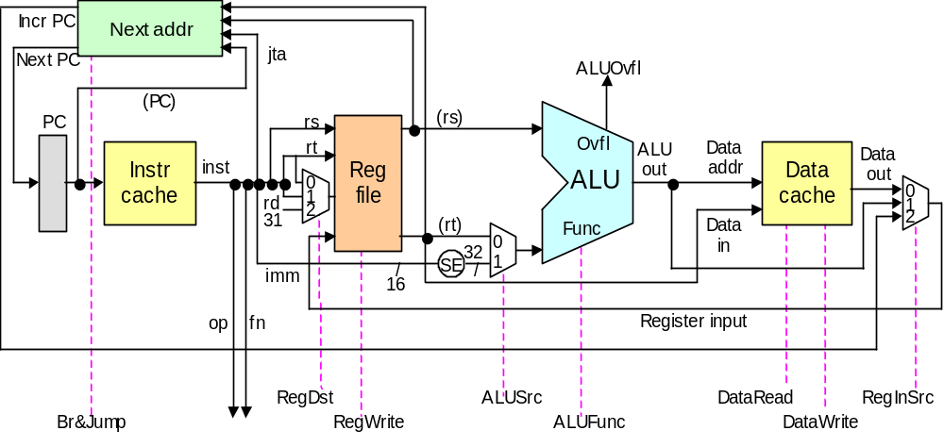
Preview of Arithmetic Unit in the Data Path
Register
writeback
Instruction fetch
Reg access / decode
ALU operation
Data access
Fig. 13.3 Key elements of the single-cycle MicroMIPS data path.
Oct. 2014
Computer Architecture, The Arithmetic/Logic Unit
Slide <number>

Slide 5
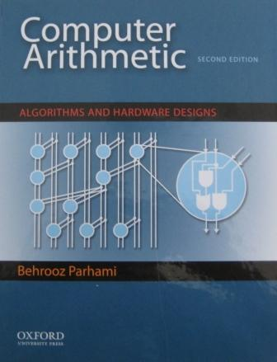
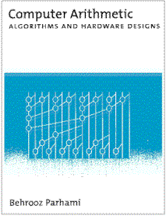
Computer Arithmetic as a Topic of Study
Brief overview article –
Encyclopedia of Info Systems,
Academic Press, 2002,
Vol. 3, pp. 317-333
Our textbook’s treatment
of the topic falls between
the extremes (4 chaps.)
Graduate course
ECE 252B – Text:
Computer Arithmetic,
Oxford U Press, 2000
(2nd ed., 2010)
Oct. 2014
Computer Architecture, The Arithmetic/Logic Unit
Slide <number>

Slide 6
9 Number Representation
Arguably the most important topic in computer arithmetic:
  Affects system compatibility and ease of arithmetic
  Two’s complement, flp, and unconventional methods
Topics in This Chapter
9.1 Positional Number Systems
9.2 Digit Sets and Encodings
9.3 Number-Radix Conversion
9.4 Signed Integers
9.5 Fixed-Point Numbers
9.6 Floating-Point Numbers
Oct. 2014
Computer Architecture, The Arithmetic/Logic Unit
Slide <number>

Slide 7
9.1 Positional Number Systems
Representations of natural numbers {0, 1, 2, 3, …}
||||| ||||| ||||| ||||| ||||| || sticks or unary code
27 radix-10 or decimal code
11011 radix-2 or binary code
XXVII Roman numerals
Fixed-radix positional representation with k digits
  Value of a number: x = (x_{k–1}x_{k–2} . . . x₁x₀)_{r} = Σ x_{i} r ^{i}
For example:
27 = (11011)_{two} = (1×2⁴) + (1×2³) + (0×2²) + (1×2¹) + (1×2⁰)
  Number of digits for [0, P]: k = ⎡log_{r} (P + 1)⎤ = ⎣log_{r} P⎦ + 1
k–1
i=0
Oct. 2014
Computer Architecture, The Arithmetic/Logic Unit
Slide <number>

Slide 8
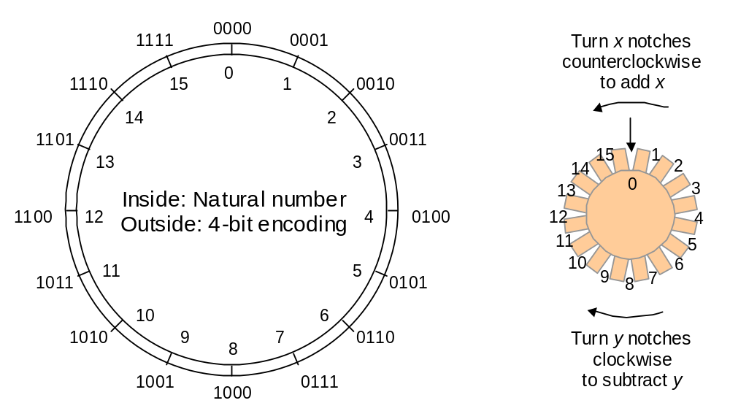
Unsigned Binary Integers
Figure 9.1 Schematic representation of 4-bit code for integers in [0, 15].
Oct. 2014
Computer Architecture, The Arithmetic/Logic Unit
Slide <number>

Slide 9
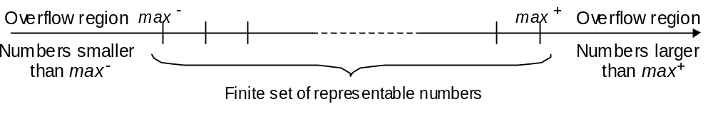
Representation Range and Overflow
Figure 9.2 Overflow regions in finite number representation systems. For unsigned representations covered in this section, max – = 0.
Example 9.2, Part d
Discuss if overflow will occur when computing 3¹⁷ – 3¹⁶ in a number
system with k = 8 digits in radix r = 10.
Solution
The result 86 093 442 is representable in the number system which
has a range [0, 99 999 999]; however, if 3¹⁷ is computed en route to
the final result, overflow will occur.
Oct. 2014
Computer Architecture, The Arithmetic/Logic Unit
Slide <number>

Slide 10
9.2 Digit Sets and Encodings
Conventional and unconventional digit sets
• Decimal digits in [0, 9]; 4-bit BCD, 8-bit ASCII
• Hexadecimal, or hex for short: digits 0-9 & a-f
• Conventional ternary digit set in [0, 2]
Conventional digit set for radix r is [0, r – 1]
Symmetric ternary digit set in [–1, 1]
• Conventional binary digit set in [0, 1]
Redundant digit set [0, 2], encoded in 2 bits
( 0 2 1 1 0 )_{two} and ( 1 0 1 0 2 )_{two} represent 22
Oct. 2014
Computer Architecture, The Arithmetic/Logic Unit
Slide <number>

Slide 11
Carry-Save Numbers
Radix-2 numbers using the digits 0, 1, and 2
Example: (1 0 2 1)_{two} = (1×2³) + (0×2²) + (2×2¹) + (1×2⁰) = 13
Possible encodings
(a) Binary (b) Unary
0 00 0 00
1 01 1 01 (First alternate)
2 10 1 10 (Second alternate)
11 (Unused) 2 11
1 0 2 1 1 0 2 1
MSB 0 0 1 0 = 2 First bit 0 0 1 1 = 3
LSB 1 0 0 1 = 9 Second bit 1 0 1 0 = 10
Oct. 2014
Computer Architecture, The Arithmetic/Logic Unit
Slide <number>

Slide 12
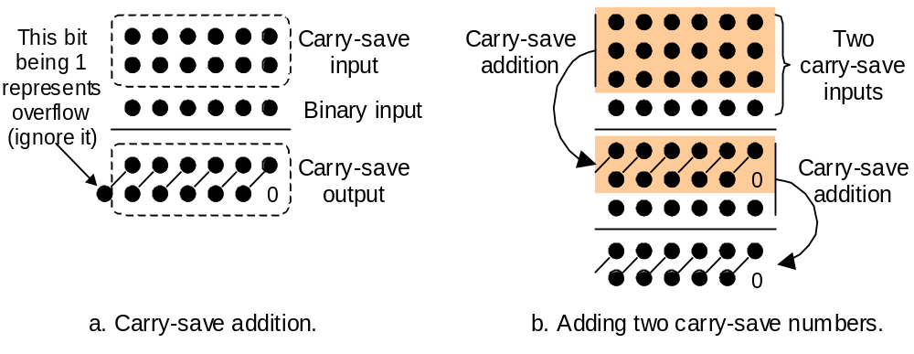
The Notion of Carry-Save Addition
Digit-set combination: {0, 1, 2} + {0, 1} = {0, 1, 2, 3} = {0, 2} + {0, 1}
Figure 9.3 Adding a binary number or another carry-save number to a carry-save number.
Oct. 2014
Computer Architecture, The Arithmetic/Logic Unit
Slide <number>

Slide 13
9.3 Number Radix Conversion
Two ways to convert numbers from an old radix r to a new radix R
• Perform arithmetic in the new radix R
Suitable for conversion from radix r to radix 10
Horner’s rule:
(x_{k–1}x_{k–2} . . . x₁x₀)_{r} = (…((0 + x_{k–1})r + x_{k–2})r + . . . + x₁)r + x₀
(1 0 1 1 0 1 0 1)_{two} = 0 + 1 → 1 × 2 + 0 → 2 × 2 + 1 → 5 × 2 + 1 →
11 × 2 + 0 → 22 × 2 + 1 → 45 × 2 + 0 → 90 × 2 + 1 → 181
• Perform arithmetic in the old radix r
Suitable for conversion from radix 10 to radix R
Divide the number by R, use the remainder as the LSD
and the quotient to repeat the process
19 / 3 → rem 1, quo 6 / 3 → rem 0, quo 2 / 3 → rem 2, quo 0
Thus, 19 = (2 0 1)_{three}
Oct. 2014
Computer Architecture, The Arithmetic/Logic Unit
Slide <number>

Slide 14
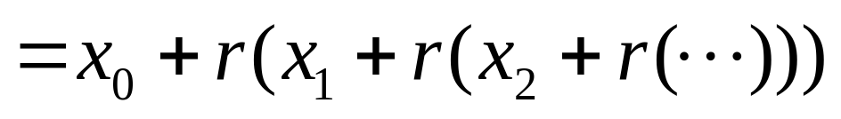
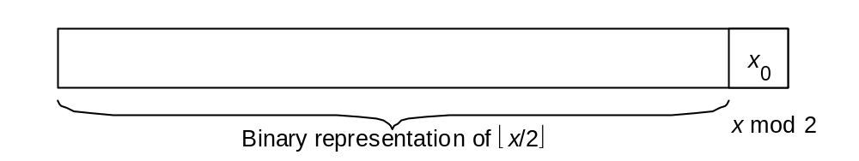
Justifications for Radix Conversion Rules
Justifying Horner’s rule.
Figure 9.4 Justifying one step of the conversion of x to radix 2.
Oct. 2014
Computer Architecture, The Arithmetic/Logic Unit
Slide <number>

Slide 15
9.4 Signed Integers
• We dealt with representing the natural numbers
• Signed or directed whole numbers = integers
{ . . . , −3, −2, −1, 0, 1, 2, 3, . . . }
• Signed-magnitude representation
+27 in 8-bit signed-magnitude binary code 0 0011011
–27 in 8-bit signed-magnitude binary code 1 0011011
–27 in 2-digit decimal code with BCD digits 1 0010 0111
• Biased representation
Represent the interval of numbers [−N, P] by the unsigned
interval [0, P + N]; i.e., by adding N to every number
Oct. 2014
Computer Architecture, The Arithmetic/Logic Unit
Slide <number>

Slide 16
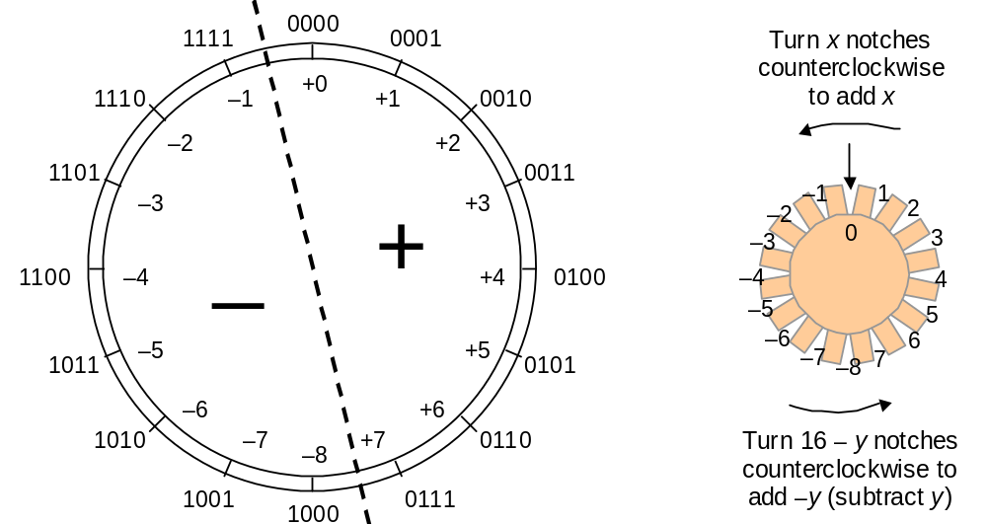
Two’s-Complement Representation
With k bits, numbers in the range [–2^{k–1}, 2^{k–1} – 1] represented.
Negation is performed by inverting all bits and adding 1.
Figure 9.5 Schematic representation of 4-bit 2’s-complement code for integers in [–8, +7].
Oct. 2014
Computer Architecture, The Arithmetic/Logic Unit
Slide <number>

Slide 17
Conversion from 2’s-Complement to Decimal
Example 9.7
Convert x = (1 0 1 1 0 1 0 1)_{2’s-compl} to decimal.
Solution
Given that x is negative, one could change its sign and evaluate –x.
Shortcut: Use Horner’s rule, but take the MSB as negative
–1 × 2 + 0 → –2 × 2 + 1 → –3 × 2 + 1 → –5 × 2 + 0 → –10 × 2 + 1 → –19 × 2 + 0 → –38 × 2 + 1 → –75
Sign Change for a 2’s-Complement Number
Example 9.8
Given y = (1 0 1 1 0 1 0 1)_{2’s-compl}, find the representation of –y.
Solution
–y = (0 1 0 0 1 0 1 0) + 1 = (0 1 0 0 1 0 1 1)_{2’s-compl} (i.e., 75)
Oct. 2014
Computer Architecture, The Arithmetic/Logic Unit
Slide <number>

Slide 18
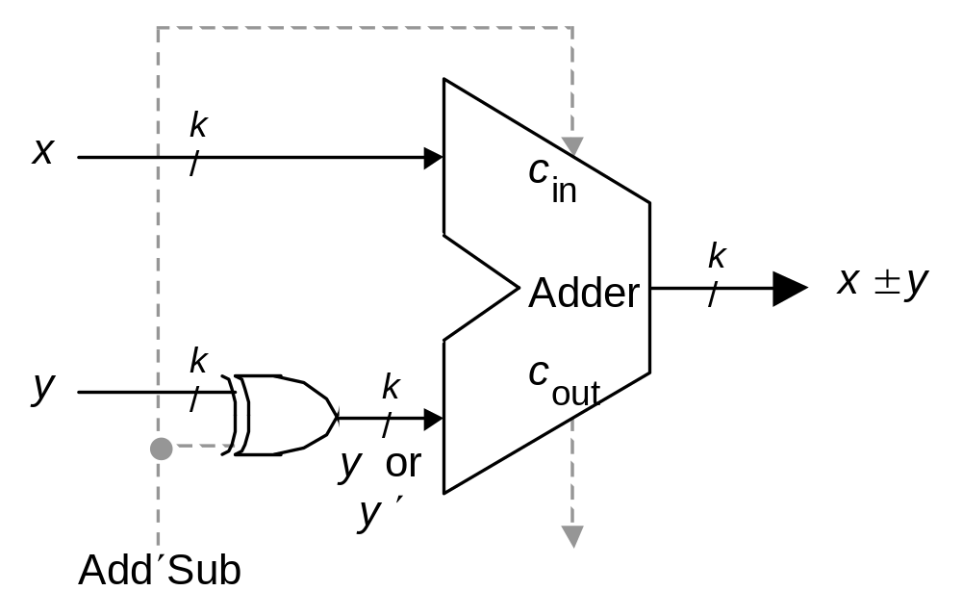
Two’s-Complement Addition and Subtraction
Figure 9.6 Binary adder used as 2’s-complement adder/subtractor.
Oct. 2014
Computer Architecture, The Arithmetic/Logic Unit
Slide <number>

Slide 19
9.5 Fixed-Point Numbers
Positional representation: k whole and l fractional digits
Value of a number: x = (x_{k–1}x_{k–2} . . . x₁x₀ . x_{–1}x_{–2} . . . x_{–l} )_{r} = Σ x_{i} r ^{i}
For example:
2.375 = (10.011)_{two} = (1×2¹) + (0×2⁰) + (0×2⁻¹) + (1×2⁻²) + (1×2⁻³)
Numbers in the range [0, r^{k} – ulp] representable, where ulp = r ^{–l}
Fixed-point arithmetic same as integer arithmetic
(radix point implied, not explicit)
Two’s complement properties (including sign change) hold here as well:
(01.011)_{2’s-compl} = (–0×2¹) + (1×2⁰) + (0×2^{–1}) + (1×2^{–2}) + (1×2^{–3}) = +1.375
(11.011)_{2’s-compl} = (–1×2¹) + (1×2⁰) + (0×2^{–1}) + (1×2^{–2}) + (1×2^{–3}) = –0.625
Oct. 2014
Computer Architecture, The Arithmetic/Logic Unit
Slide <number>

Slide 20
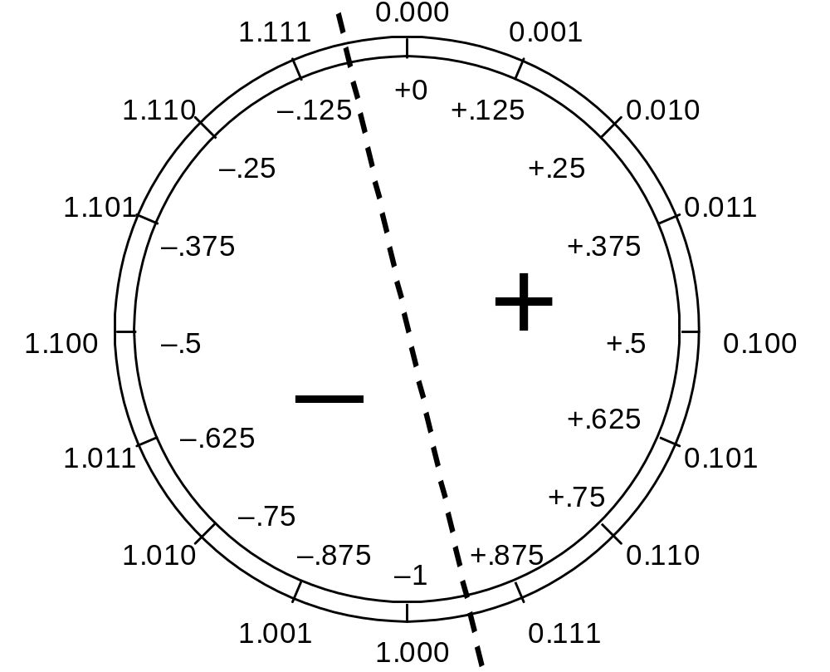
Fixed-Point 2’s-Complement Numbers
Figure 9.7 Schematic representation of 4-bit 2’s-complement encoding for (1 + 3)-bit fixed-point numbers in the range [–1, +7/8].
Oct. 2014
Computer Architecture, The Arithmetic/Logic Unit
Slide <number>

Slide 21
Radix Conversion for Fixed-Point Numbers
Convert the whole and fractional parts separately.
To convert the fractional part from an old radix r to a new radix R:
• Perform arithmetic in the new radix R
Evaluate a polynomial in r ^{–1}: (.011)_{two} = 0 × 2^{–1} + 1 × 2^{–2} + 1 × 2^{–3}
Simpler: View the fractional part as integer, convert, divide by r ^{l}
(.011)_{two} = (?)_{ten}
Multiply by 8 to make the number an integer: (011)_{two} = (3)_{ten}
Thus, (.011)_{two} = (3 / 8)_{ten} = (.375)_{ten}
• Perform arithmetic in the old radix r
Multiply the given fraction by R, use the whole part as the MSD
and the fractional part to repeat the process
(.72)_{ten} = (?)_{two}
0.72 × 2 = 1.44, so the answer begins with 0.1
0.44 × 2 = 0.88, so the answer begins with 0.10
Oct. 2014
Computer Architecture, The Arithmetic/Logic Unit
Slide <number>

Slide 22
9.6 Floating-Point Numbers
Useful for applications where very large and very small numbers are needed simultaneously
• Fixed-point representation must sacrifice precision
for small values to represent large values
x = (0000 0000 . 0000 1001)_{two} Small number
y = (1001 0000 . 0000 0000)_{two} Large number
• Neither y² nor y / x is representable in the format above
• Floating-point representation is like scientific notation:
−20 000 000 = −2 × 10 ⁷ +0.000 000 007 = +7 × 10^{–9}
Also, 7E−9
Sign
Exponent
Significand
Exponent base
Oct. 2014
Computer Architecture, The Arithmetic/Logic Unit
Slide <number>

Slide 23
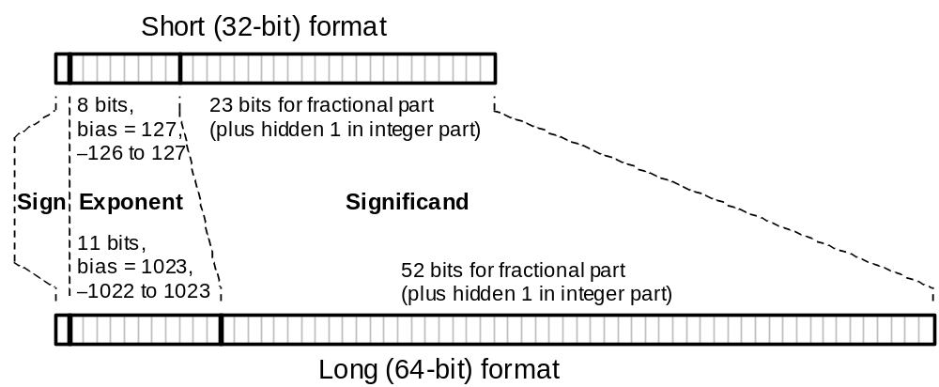
ANSI/IEEE Standard Floating-Point Format (IEEE 754)
Revision (IEEE 754R) was completed in 2008: The revised version includes 16-bit and 128-bit binary formats, as well as 64- and 128-bit decimal formats
Short exponent range is –127 to 128
but the two extreme values
are reserved for special operands
(similarly for the long format)
Figure 9.8 The two ANSI/IEEE standard floating-point formats.
Oct. 2014
Computer Architecture, The Arithmetic/Logic Unit
Slide <number>

Slide 24
Short and Long IEEE 754 Formats: Features
Table 9.1 Some features of ANSI/IEEE standard floating-point formats
Feature | Single/Short | Double/Long
Word width in bits | 32 | 64
Significand in bits | 23 + 1 hidden | 52 + 1 hidden
Significand range | [1, 2 – 2^{–23}] | [1, 2 – 2^{–52}]
Exponent bits | 8 | 11
Exponent bias | 127 | 1023
Zero (±0) | e + bias = 0, f = 0 | e + bias = 0, f = 0
Denormal | e + bias = 0, f ≠ 0 represents ±0.f × 2^{–126} | e + bias = 0, f ≠ 0 represents ±0.f × 2^{–1022}
Infinity (±∞) | e + bias = 255, f = 0 | e + bias = 2047, f = 0
Not-a-number (NaN) | e + bias = 255, f ≠ 0 | e + bias = 2047, f ≠ 0
Ordinary number | e + bias ∈ [1, 254] e ∈ [–126, 127] represents 1.f × 2e | e + bias ∈ [1, 2046] e ∈ [–1022, 1023] represents 1.f × 2e
min | 2^{–126} ≅ 1.2 × 10^{–38} | 2^{–1022} ≅ 2.2 × 10^{–308}
max | ≅ 2¹²⁸ ≅ 3.4 × 10³⁸ | ≅ 2¹⁰²⁴ ≅ 1.8 × 10³⁰⁸
Subnormal
Oct. 2014
Computer Architecture, The Arithmetic/Logic Unit
Slide <number>

Slide 25
10 Adders and Simple ALUs
Addition is the most important arith operation in computers:
  Even the simplest computers must have an adder
  An adder, plus a little extra logic, forms a simple ALU
Topics in This Chapter
10.1 Simple Adders
10.2 Carry Propagation Networks
10.3 Counting and Incrementation
10.4 Design of Fast Adders
10.5 Logic and Shift Operations
10.6 Multifunction ALUs
Oct. 2014
Computer Architecture, The Arithmetic/Logic Unit
Slide <number>

Slide 26
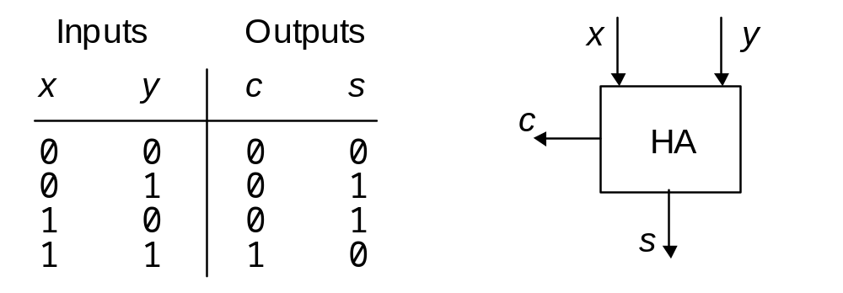
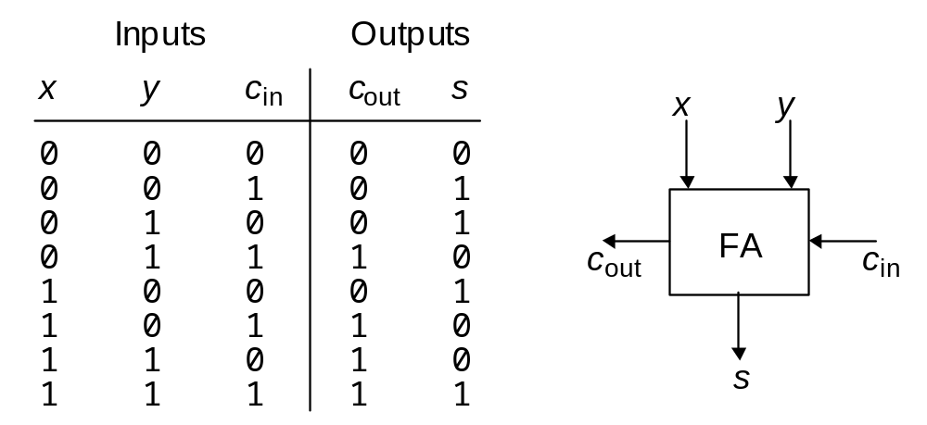
10.1 Simple Adders
Digit-set interpretation:
{0, 1} + {0, 1}
= {0, 2} + {0, 1}
Digit-set interpretation:
{0, 1} + {0, 1} + {0, 1}
= {0, 2} + {0, 1}
Figures 10.1/10.2 Binary half-adder (HA) and full-adder (FA).
Oct. 2014
Computer Architecture, The Arithmetic/Logic Unit
Slide <number>

Slide 27
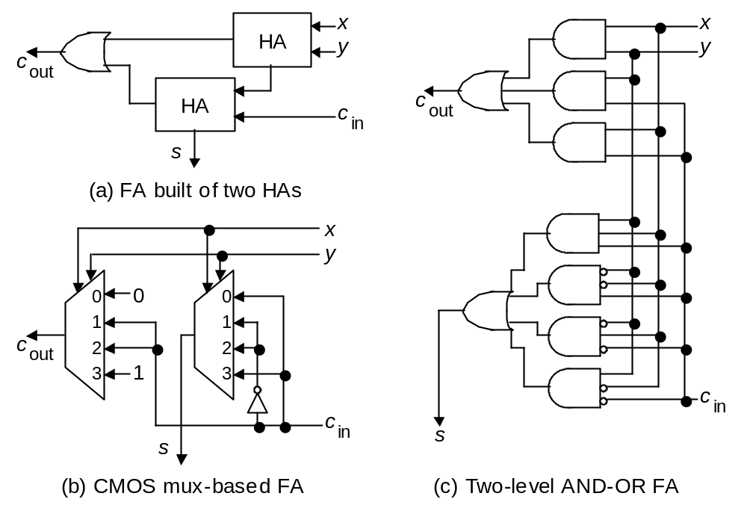
Full-Adder Implementations
Figure10.3 Full adder implemented with two half-adders, by means of two 4-input multiplexers, and as two-level gate network.
Oct. 2014
Computer Architecture, The Arithmetic/Logic Unit
Slide <number>

Slide 28
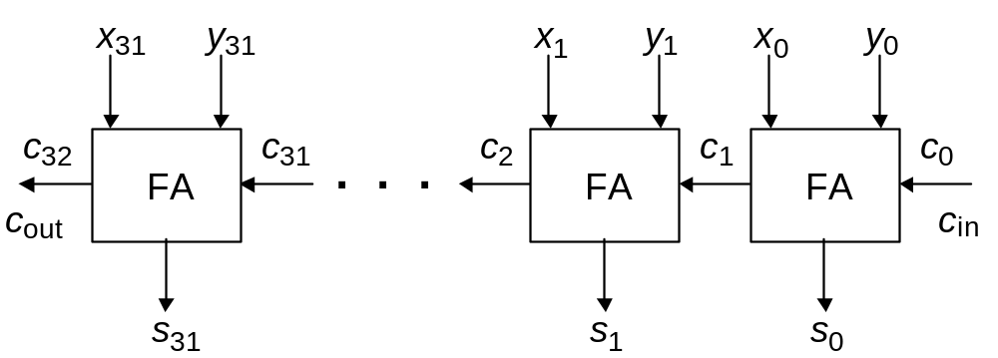
Ripple-Carry Adder: Slow But Simple
Critical path
Figure 10.4 Ripple-carry binary adder with 32-bit inputs and output.
Oct. 2014
Computer Architecture, The Arithmetic/Logic Unit
Slide <number>

Slide 29
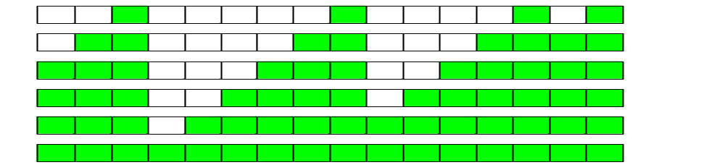
Carry Chains and Auxiliary Signals
Bit positions
15 14 13 12 11 10 9 8 7 6 5 4 3 2 1 0
----------- ----------- ----------- -----------
1 0 1 1 0 1 1 0 0 1 1 0 1 1 1 0
c_{out} 0 1 0 1 1 0 0 1 1 1 0 0 0 0 1 1 c_{in}
\__________/\__________________/ \________/\____/
4 6 3 2
Carry chains and their lengths
g = xy
p = x ⊕ y
Oct. 2014
Computer Architecture, The Arithmetic/Logic Unit
Slide <number>

Slide 30
Carry Chains Illustrated with Dominoes
Oct. 2014
Computer Architecture, The Arithmetic/Logic Unit
Slide <number>

Slide 31
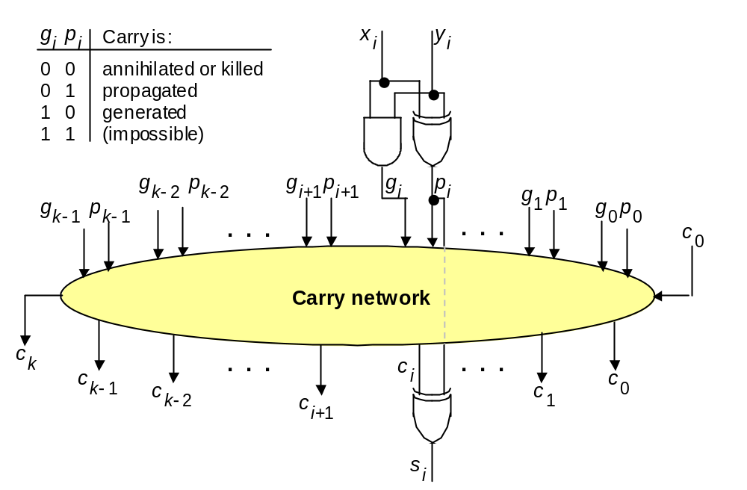
10.2 Carry Propagation Networks
g_{i} = x_{i} y_{i}
p_{i} = x_{i} ⊕ y_{i}
Figure 10.5 The main part of an adder is the carry network. The rest is just a set of gates to produce the g and p signals and the sum bits.
Oct. 2014
Computer Architecture, The Arithmetic/Logic Unit
Slide <number>

Slide 32
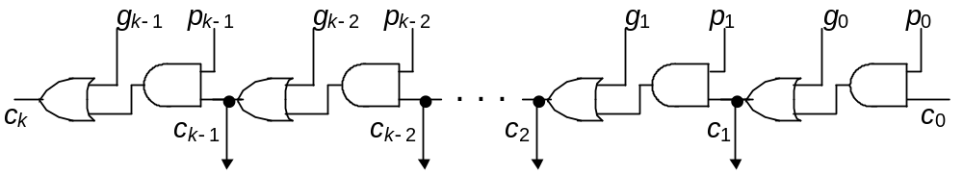
Ripple-Carry Adder Revisited
The carry recurrence: c_{i+1} = g_{i} ∨ p_{i} c_{i}
Latency of k-bit adder is roughly 2k gate delays:
1 gate delay for production of p and g signals, plus
2(k – 1) gate delays for carry propagation, plus
1 XOR gate delay for generation of the sum bits
Figure 10.6 The carry propagation network of a ripple-carry adder.
Oct. 2014
Computer Architecture, The Arithmetic/Logic Unit
Slide <number>

Slide 33
The Complete Design of a Ripple-Carry Adder
g_{i} = x_{i} y_{i}
p_{i} = x_{i} ⊕ y_{i}
Figure 10.6 (ripple-carry network) superimposed on Figure 10.5 (general structure of an adder).
Oct. 2014
Computer Architecture, The Arithmetic/Logic Unit
Slide <number>

Slide 34
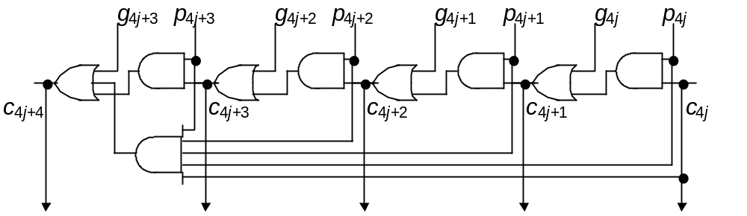
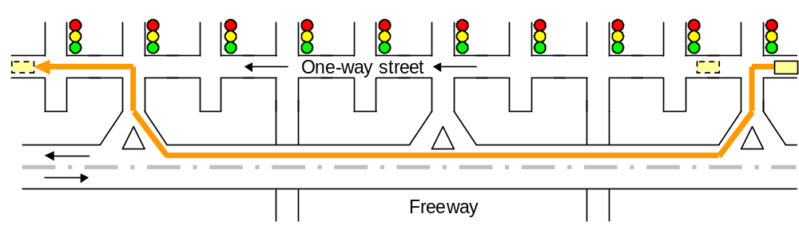
First Carry Speed-Up Method: Carry Skip
Figures 10.7/10.8 A 4-bit section of a ripple-carry network with skip paths and the driving analogy.
Oct. 2014
Computer Architecture, The Arithmetic/Logic Unit
Slide <number>

Slide 35
Mux-Based Skip Carry Logic
Fig. 10.7
0
1
c_{4j+4}
p_{[4j, 4j+3]}
The carry-skip adder of Fig. 10.7 works fine if we begin with a clean slate, where all signals are 0s; otherwise, it will run into problems, which do not exist in this mux-based implementation
Oct. 2014
Computer Architecture, The Arithmetic/Logic Unit
Slide <number>

Slide 36
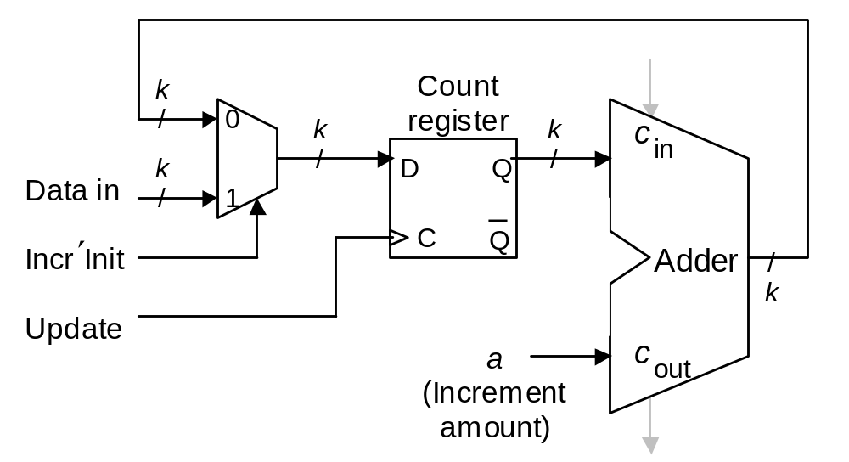
10.3 Counting and Incrementation
Figure 10.9 Schematic diagram of an initializable synchronous counter.
Oct. 2014
Computer Architecture, The Arithmetic/Logic Unit
Slide <number>

Slide 37
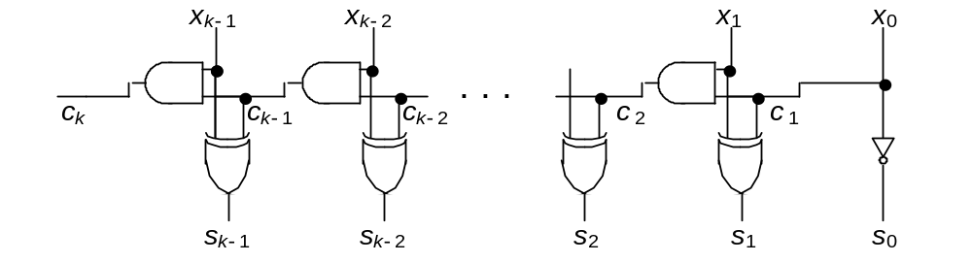
Circuit for Incrementation by 1
Figure 10.6
0
0
Substantially simpler than an adder
x₁
x₀
1
Figure 10.10 Carry propagation network and sum logic for an incrementer.
Oct. 2014
Computer Architecture, The Arithmetic/Logic Unit
Slide <number>

Slide 38
10.4 Design of Fast Adders
• Carries can be computed directly without propagation
• For example, by unrolling the equation for c₃, we get:
c₃ = g₂ ∨ p₂ c₂ = g₂ ∨ p₂ g₁ ∨ p₂ p₁ g₀ ∨ p₂ p₁ p₀ c₀
• We define “generate” and “propagate” signals for a block
extending from bit position a to bit position b as follows:
g_{[a,b]} = g_{b} ∨ p_{b} g_{b–1} ∨ p_{b} p_{b–1} g_{b–2} ∨ . . . ∨ p_{b} p_{b–1} … p_{a+1} g_{a}
p_{[a,b]} = p_{b} p_{b–1} . . . p_{a+1} p_{a}
• Combining g and p signals for adjacent blocks:
g_{[h,j]} = g_{[i+1,j]} ∨ p_{[i+1,j]} g_{[h,i]}
p_{[h,j]} = p_{[i+1,j]} p_{[h,i]}
j
i+1
i
h
[h, j] = [i + 1, j] ¢ [h, i]
Oct. 2014
Computer Architecture, The Arithmetic/Logic Unit
Slide <number>

Slide 39
Carries as Generate Signals for Blocks [ 0, i ]
Assuming c₀ = 0, we have c_{i} = g _{[0,i –1]}
Figure 10.5
Oct. 2014
Computer Architecture, The Arithmetic/Logic Unit
Slide <number>

Slide 40
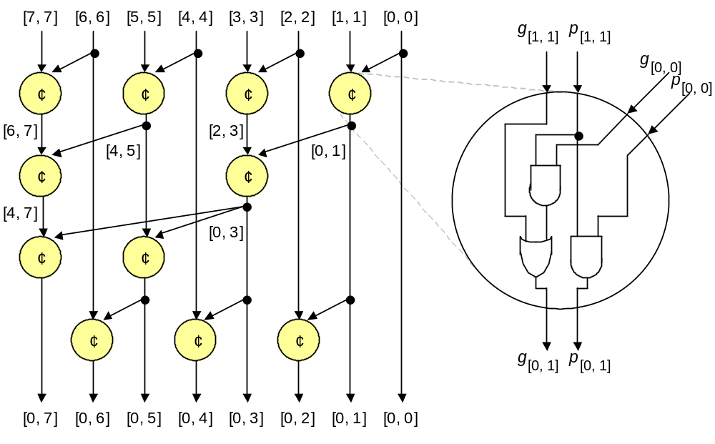
Second Carry Speed-Up Method: Carry Lookahead
Figure 10.11 Brent-Kung lookahead carry network for an 8-digit adder, along with details of one of the carry operator blocks.
Oct. 2014
Computer Architecture, The Arithmetic/Logic Unit
Slide <number>

Slide 41
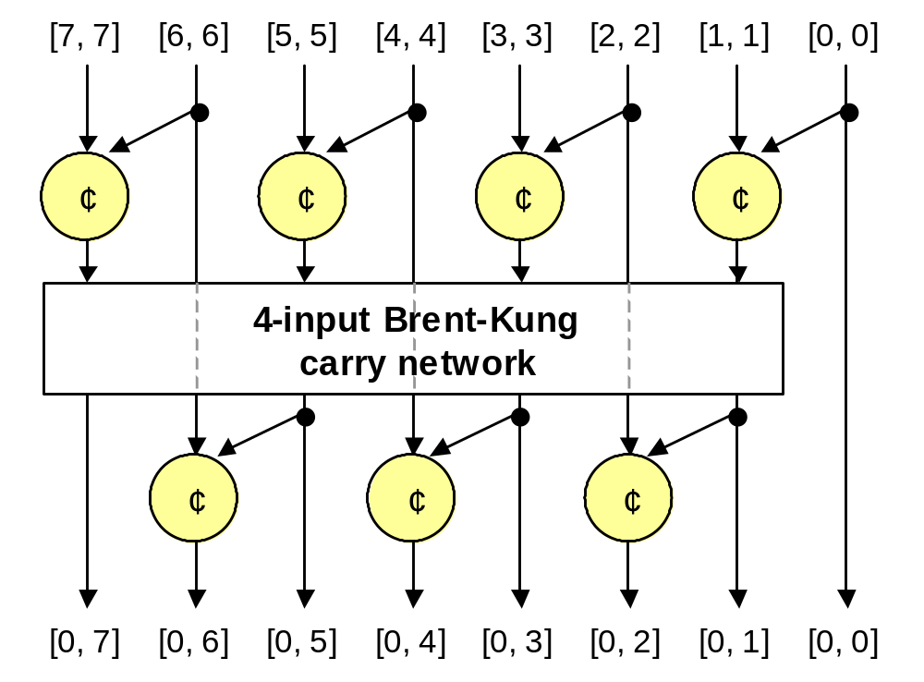
Recursive Structure of Brent-Kung Carry Network
Figure 10.12 Brent-Kung lookahead carry network for an 8-digit adder, with only its top and bottom rows of carry-operators shown.
Oct. 2014
Computer Architecture, The Arithmetic/Logic Unit
Slide <number>

Slide 42
An Alternate Design: Kogge-Stone Network
¢
¢
¢
¢
¢
¢
¢
¢
¢
¢
¢
¢
¢
¢
¢
¢
¢
c₇ = g _{[0,6]}
c₅ = g _{[0,4]}
c₃ = g _{[0,2]}
c₁ = g _{[0,0]}
c₈ = g _{[0,7]}
c₆ = g _{[0,5]}
c₄ = g _{[0,3]}
c₂ = g _{[0,1]}
Kogge-Stone lookahead carry network for an 8-digit adder.
Oct. 2014
Computer Architecture, The Arithmetic/Logic Unit
Slide <number>

Slide 43
Brent-Kung vs. Kogge-Stone Carry Network
11 carry operators
4 levels
17 carry operators
3 levels
Oct. 2014
Computer Architecture, The Arithmetic/Logic Unit
Slide <number>

Slide 44
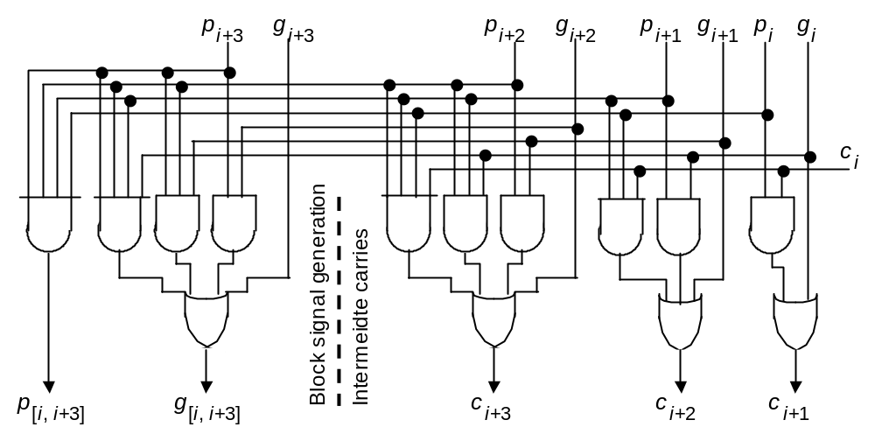
Carry-Lookahead Logic with 4-Bit Block
Figure 10.13 Blocks needed in the design of carry-lookahead adders with four-way grouping of bits.
Oct. 2014
Computer Architecture, The Arithmetic/Logic Unit
Slide <number>

Slide 45
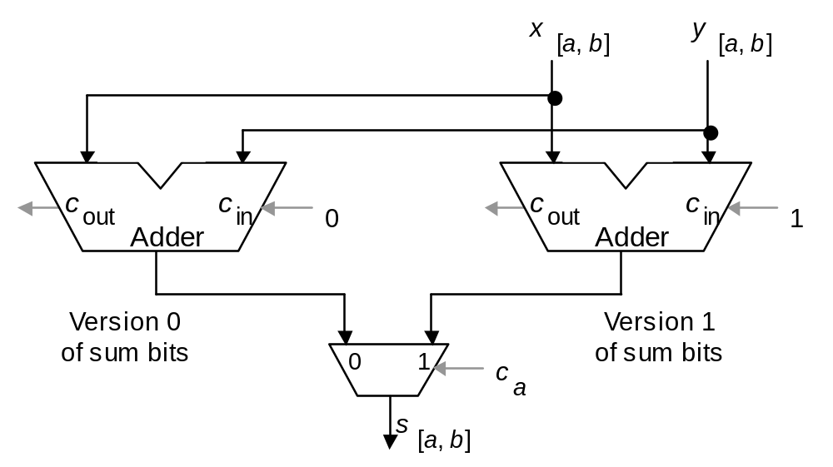
Third Carry Speed-Up Method: Carry Select
Allows doubling of adder width with a single-mux additional delay
The lower
a positions,
(0 to a – 1)
are added
as usual
Figure 10.14 Carry-select addition principle.
Oct. 2014
Computer Architecture, The Arithmetic/Logic Unit
Slide <number>

Slide 46
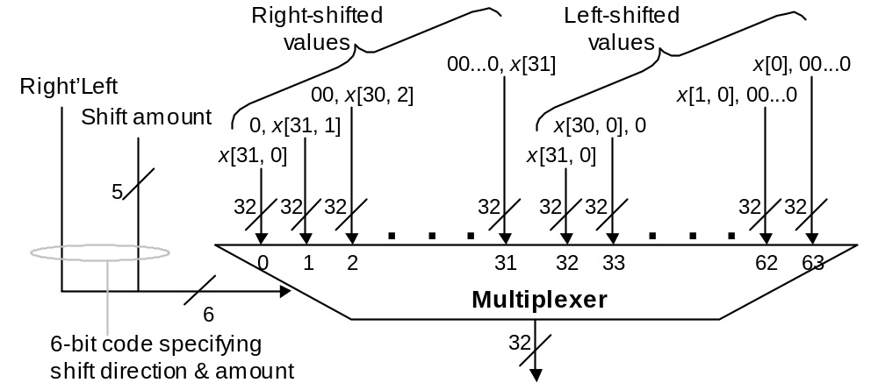
10.5 Logic and Shift Operations
Conceptually, shifts can be implemented by multiplexing
Figure 10.15 Multiplexer-based logical shifting unit.
Oct. 2014
Computer Architecture, The Arithmetic/Logic Unit
Slide <number>

Slide 47
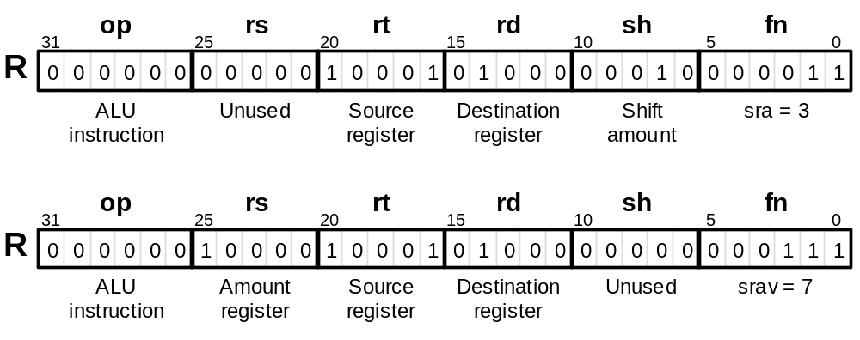
Arithmetic Shifts
Purpose: Multiplication and division by powers of 2
sra $t0,$s1,2 # $t0 ← ($s1) right-shifted by 2
srav $t0,$s1,$s0 # $t0 ← ($s1) right-shifted by ($s0)
Figure 10.16 The two arithmetic shift instructions of MiniMIPS.
Oct. 2014
Computer Architecture, The Arithmetic/Logic Unit
Slide <number>

Slide 48
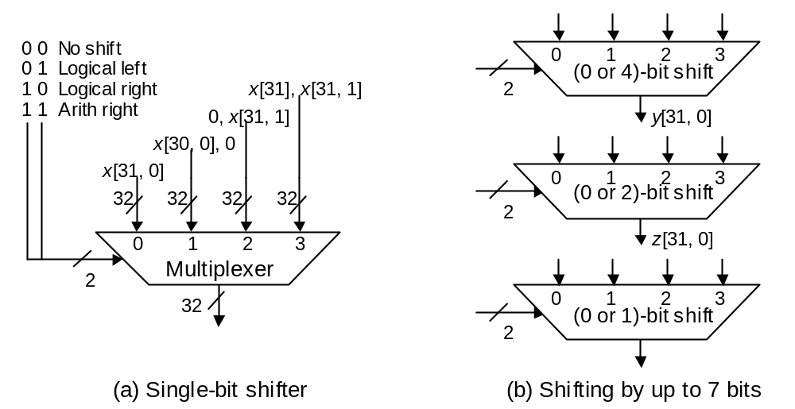
Practical Shifting in Multiple Stages
Figure 10.17 Multistage shifting in a barrel shifter.
Oct. 2014
Computer Architecture, The Arithmetic/Logic Unit
Slide <number>

Slide 49
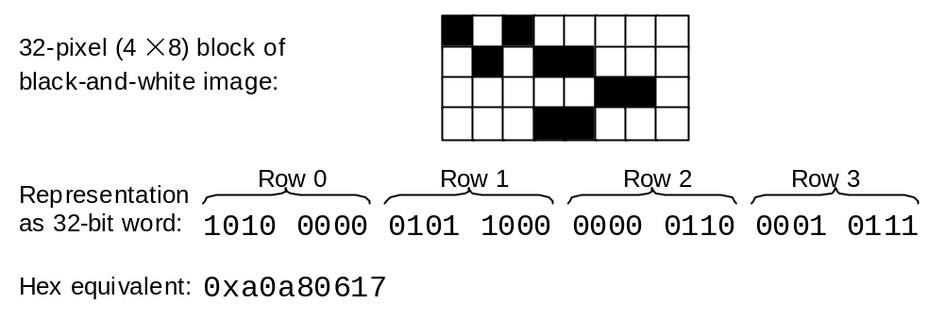
Bit Manipulation via Shifts and Logical Operations
Bits 10-15
AND with mask to isolate a field: 0000 0000 0000 0000 1111 1100 0000 0000
Right-shift by 10 positions to move field to the right end of word
The result word ranges from 0 to 63, depending on the field pattern
Figure 10.18 A 4 × 8 block of a black-and-white image represented as a 32-bit word.
Oct. 2014
Computer Architecture, The Arithmetic/Logic Unit
Slide <number>

Slide 50
10.6 Multifunction ALUs
Arith fn (add, sub, . . .)
Operand 1
Arith
unit
0
Result
Logic
unit
1
Operand 2
Select fn type
(logic or arith)
Logic fn (AND, OR, . . .)
General structure of a simple arithmetic/logic unit.
Oct. 2014
Computer Architecture, The Arithmetic/Logic Unit
Slide <number>

Slide 51
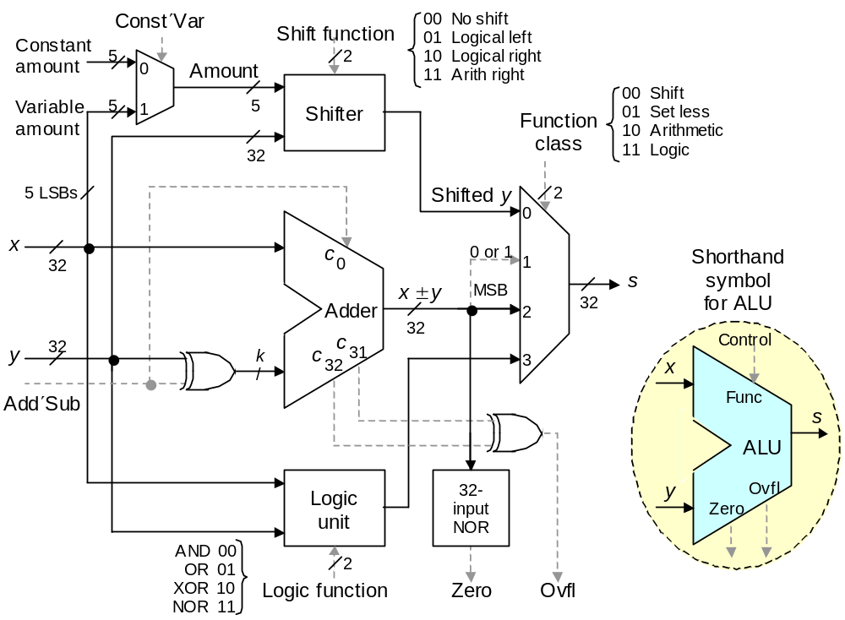
An ALU for MiniMIPS
Figure 10.19 A multifunction ALU with 8 control signals (2 for function class, 1 arithmetic, 3 shift, 2 logic) specifying the operation.
Oct. 2014
Computer Architecture, The Arithmetic/Logic Unit
Slide <number>

Slide 52
11 Multipliers and Dividers
Modern processors perform many multiplications & divisions:
  Encryption, image compression, graphic rendering
  Hardware vs programmed shift-add/sub algorithms
Topics in This Chapter
11.1 Shift-Add Multiplication
11.2 Hardware Multipliers
11.3 Programmed Multiplication
11.4 Shift-Subtract Division
11.5 Hardware Dividers
11.6 Programmed Division
Oct. 2014
Computer Architecture, The Arithmetic/Logic Unit
Slide <number>

Slide 53
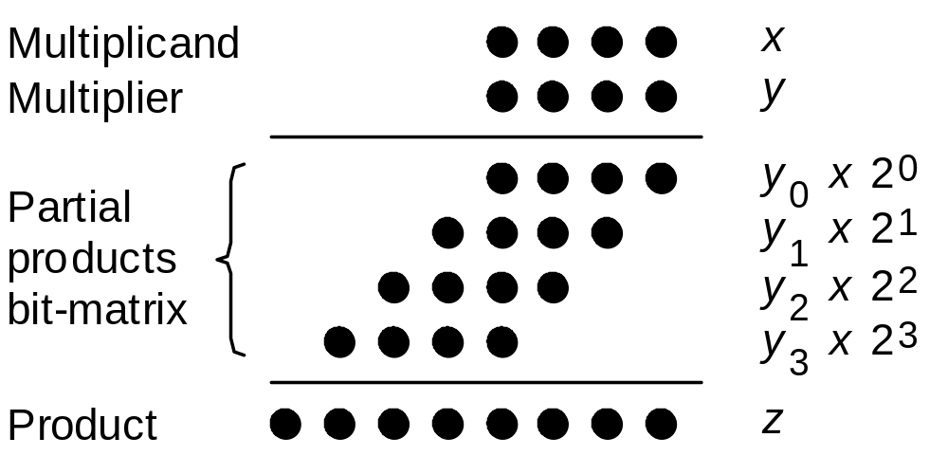
11.1 Shift-Add Multiplication
Figure 11.1 Multiplication of 4-bit numbers in dot notation.
z^{(j+1)} = (z^{(j)} + y_{j} x 2^{k}) 2^{–1} with z⁽⁰⁾ = 0 and z^{(k)} = z
|––– add –––|
|–– shift right ––|
Oct. 2014
Computer Architecture, The Arithmetic/Logic Unit
Slide <number>

Slide 54
Binary and Decimal Multiplication
Example 11.1
Position 7 6 5 4 3 2 1 0 Position 7 6 5 4 3 2 1 0
========================= =========================
x2⁴ 1 0 1 0 x10⁴ 3 5 2 8
y 0 0 1 1 y 4 0 6 7
========================= =========================
z ⁽⁰⁾ 0 0 0 0 z ⁽⁰⁾ 0 0 0 0
+y₀x2⁴ 1 0 1 0 +y₀x10⁴ 2 4 6 9 6
–––––––––––––––––––––––––– ––––––––––––––––––––––––––
2z ⁽¹⁾ 0 1 0 1 0 10z ⁽¹⁾ 2 4 6 9 6
z ⁽¹⁾ 0 1 0 1 0 z ⁽¹⁾ 0 2 4 6 9 6
+y₁x2⁴ 1 0 1 0 +y₁x10⁴ 2 1 1 6 8
–––––––––––––––––––––––––– ––––––––––––––––––––––––––
2z ⁽²⁾ 0 1 1 1 1 0 10z ⁽²⁾ 2 3 6 3 7 6
z ⁽²⁾ 0 1 1 1 1 0 z ⁽²⁾ 2 3 6 3 7 6
+y₂x2⁴ 0 0 0 0 +y₂x10⁴ 0 0 0 0 0
–––––––––––––––––––––––––– ––––––––––––––––––––––––––
2z ⁽³⁾ 0 0 1 1 1 1 0 10z ⁽³⁾ 0 2 3 6 3 7 6
z ⁽³⁾ 0 0 1 1 1 1 0 z ⁽³⁾ 0 2 3 6 3 7 6
+y₃x2⁴ 0 0 0 0 +y₃x10⁴ 1 4 1 1 2
–––––––––––––––––––––––––– ––––––––––––––––––––––––––
2z ⁽⁴⁾ 0 0 0 1 1 1 1 0 10z ⁽⁴⁾ 1 4 3 4 8 3 7 6
z ⁽⁴⁾ 0 0 0 1 1 1 1 0 z ⁽⁴⁾ 1 4 3 4 8 3 7 6
========================= =========================
Figure 11.2 Step-by-step multiplication examples for 4-digit unsigned numbers.
Oct. 2014
Computer Architecture, The Arithmetic/Logic Unit
Slide <number>

Slide 55
Two’s-Complement Multiplication
Example 11.2
Position 7 6 5 4 3 2 1 0 Position 7 6 5 4 3 2 1 0
========================= =========================
x2⁴ 1 0 1 0 x2⁴ 1 0 1 0
y 0 0 1 1 y 1 0 1 1
========================= =========================
z ⁽⁰⁾ 0 0 0 0 0 z ⁽⁰⁾ 0 0 0 0 0
+y₀x2⁴ 1 1 0 1 0 +y₀x2⁴ 1 1 0 1 0
–––––––––––––––––––––––––– ––––––––––––––––––––––––––
2z ⁽¹⁾ 1 1 0 1 0 2z ⁽¹⁾ 1 1 0 1 0
z ⁽¹⁾ 1 1 1 0 1 0 z ⁽¹⁾ 1 1 1 0 1 0
+y₁x2⁴ 1 1 0 1 0 +y₁x2⁴ 1 1 0 1 0
–––––––––––––––––––––––––– ––––––––––––––––––––––––––
2z ⁽²⁾ 1 0 1 1 1 0 2z ⁽²⁾ 1 0 1 1 1 0
z ⁽²⁾ 1 1 0 1 1 1 0 z ⁽²⁾ 1 1 0 1 1 1 0
+y₂x2⁴ 0 0 0 0 0 +y₂x2⁴ 0 0 0 0 0
–––––––––––––––––––––––––– ––––––––––––––––––––––––––
2z ⁽³⁾ 1 1 0 1 1 1 0 2z ⁽³⁾ 1 1 0 1 1 1 0
z ⁽³⁾ 1 1 1 0 1 1 1 0 z ⁽³⁾ 1 1 1 0 1 1 1 0
+(–y₃x2⁴) 0 0 0 0 0 +(–y₃x2⁴) 0 0 1 1 0
–––––––––––––––––––––––––– ––––––––––––––––––––––––––
2z ⁽⁴⁾ 1 1 1 0 1 1 1 0 2z ⁽⁴⁾ 0 0 0 1 1 1 1 0
z ⁽⁴⁾ 1 1 1 0 1 1 1 0 z ⁽⁴⁾ 0 0 0 1 1 1 1 0
========================= =========================
Figure 11.3 Step-by-step multiplication examples for 2’s-complement numbers.
Oct. 2014
Computer Architecture, The Arithmetic/Logic Unit
Slide <number>

Slide 56
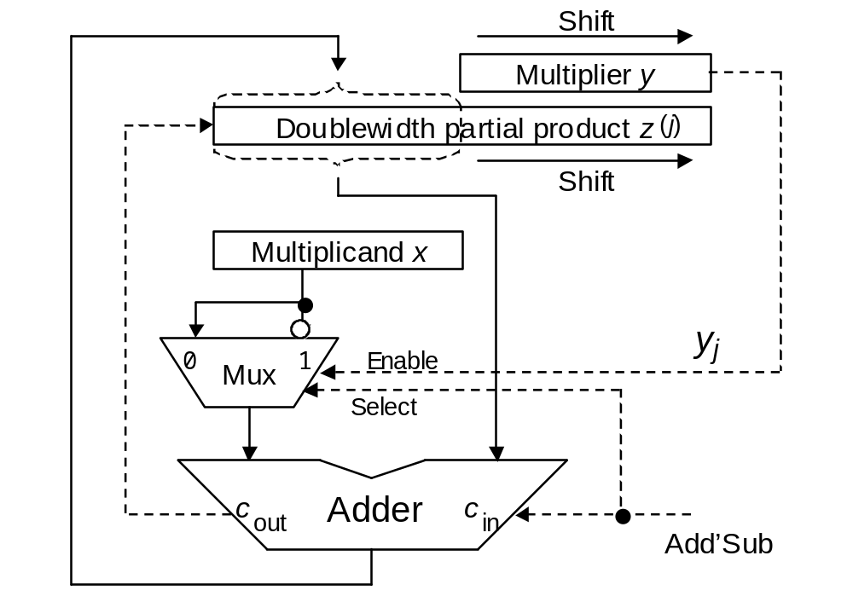
11.2 Hardware Multipliers
Hi
Lo
Figure 11.4 Hardware multiplier based on the shift-add algorithm.
Oct. 2014
Computer Architecture, The Arithmetic/Logic Unit
Slide <number>

Slide 57
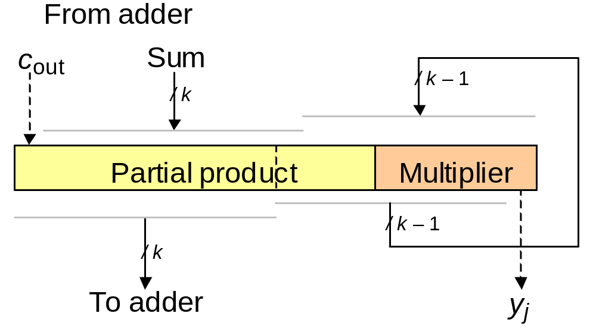
The Shift Part of Shift-Add
Figure11.5 Shifting incorporated in the connections to the partial product register rather than as a separate phase.
Oct. 2014
Computer Architecture, The Arithmetic/Logic Unit
Slide <number>

Slide 58
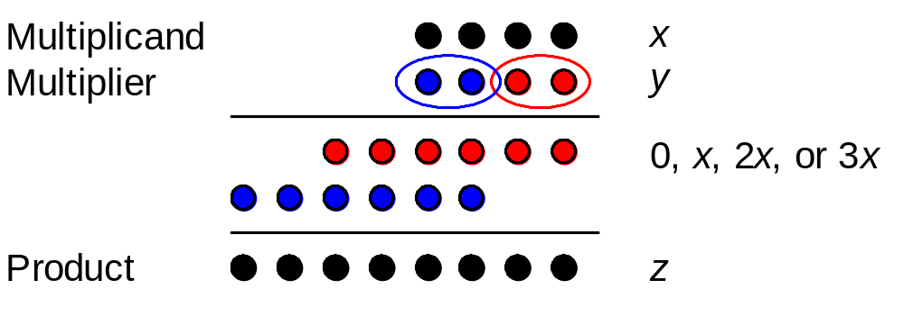
High-Radix Multipliers
Radix-4 multiplication in dot notation.
z^{(j+1)} = (z^{(j)} + y_{j} x 2^{k}) 4^{–1} with z⁽⁰⁾ = 0 and z^{(k/2)} = z
|––– add –––|
|–– shift right ––|
Assume k even
Oct. 2014
Computer Architecture, The Arithmetic/Logic Unit
Slide <number>

Slide 59
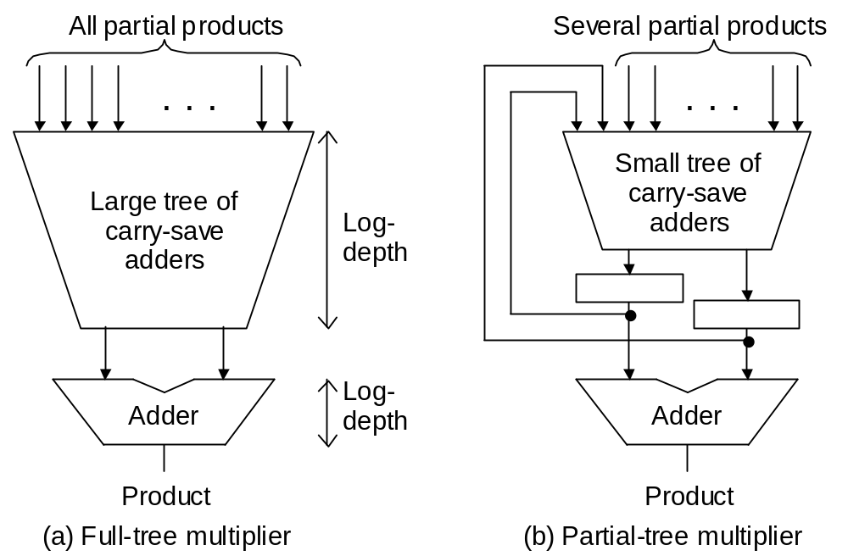
Tree Multipliers
Figure 11.6 Schematic diagram for full/partial-tree multipliers.
Oct. 2014
Computer Architecture, The Arithmetic/Logic Unit
Slide <number>

Slide 60
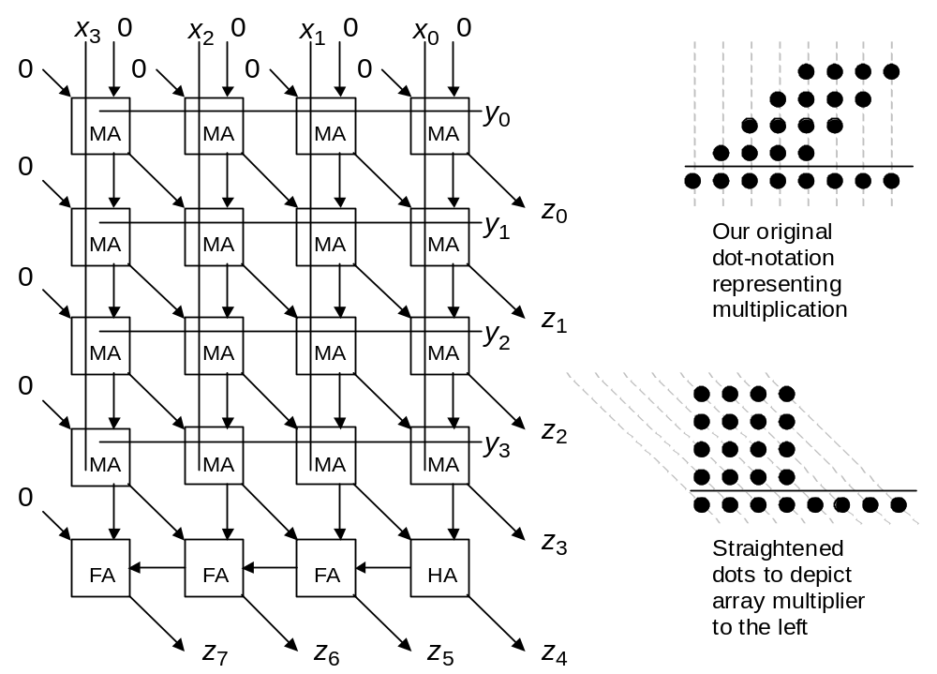
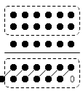
Array Multipliers
s
c
Figure 9.3a (Recalling carry-save addition)
Figure 11.7 Array multiplier for 4-bit unsigned operands.
Oct. 2014
Computer Architecture, The Arithmetic/Logic Unit
Slide <number>

Slide 61
11.3 Programmed Multiplication
MiniMIPS instructions related to multiplication
mult $s0,$s1 # set Hi,Lo to ($s0)×($s1); signed
multu $s2,$s3 # set Hi,Lo to ($s2)×($s3); unsigned
mfhi $t0 # set $t0 to (Hi)
mflo $t1 # set $t1 to (Lo)
Example 11.3
Finding the 32-bit product of 32-bit integers in MiniMIPS
Multiply; result will be obtained in Hi,Lo
For unsigned multiplication:
Hi should be all-0s and Lo holds the 32-bit result
For signed multiplication:
Hi should be all-0s or all-1s, depending on the sign bit of Lo
Oct. 2014
Computer Architecture, The Arithmetic/Logic Unit
Slide <number>

Slide 62
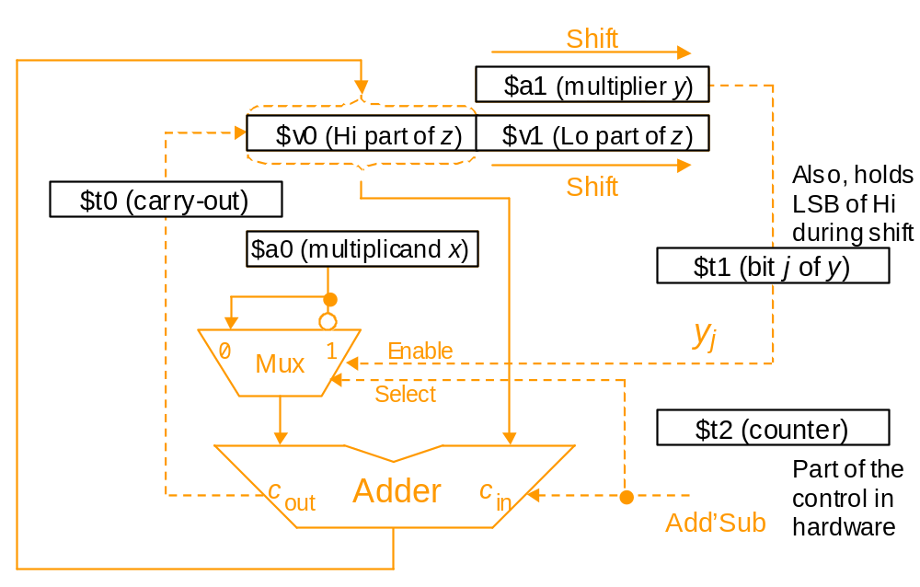
Emulating a Hardware Multiplier in Software
Example 11.4 (MiniMIPS shift-add program for multiplication)
Figure 11.8 Register usage for programmed multiplication superimposed on the block diagram for a hardware multiplier.
Oct. 2014
Computer Architecture, The Arithmetic/Logic Unit
Slide <number>

Slide 63
Multiplication When There Is No Multiply Instruction
Example 11.4 (MiniMIPS shift-add program for multiplication)
shamu: move $v0,$zero # initialize Hi to 0
move $vl,$zero # initialize Lo to 0
addi $t2,$zero,32 # init repetition counter to 32
mloop: move $t0,$zero # set c-out to 0 in case of no add
move $t1,$a1 # copy ($a1) into $t1
srl $a1,1 # halve the unsigned value in $a1
subu $t1,$t1,$a1 # subtract ($a1) from ($t1) twice to
subu $t1,$t1,$a1 # obtain LSB of ($a1), or y[j], in $t1
beqz $t1,noadd # no addition needed if y[j] = 0
addu $v0,$v0,$a0 # add x to upper part of z
sltu $t0,$v0,$a0 # form carry-out of addition in $t0
noadd: move $t1,$v0 # copy ($v0) into $t1
srl $v0,1 # halve the unsigned value in $v0
subu $t1,$t1,$v0 # subtract ($v0) from ($t1) twice to
subu $t1,$t1,$v0 # obtain LSB of Hi in $t1
sll $t0,$t0,31 # carry-out converted to 1 in MSB of $t0
addu $v0,$v0,$t0 # right-shifted $v0 corrected
srl $v1,1 # halve the unsigned value in $v1
sll $t1,$t1,31 # LSB of Hi converted to 1 in MSB of $t1
addu $v1,$v1,$t1 # right-shifted $v1 corrected
addi $t2,$t2,-1 # decrement repetition counter by 1
bne $t2,$zero,mloop # if counter > 0, repeat multiply loop
jr $ra # return to the calling program
Oct. 2014
Computer Architecture, The Arithmetic/Logic Unit
Slide <number>

Slide 64
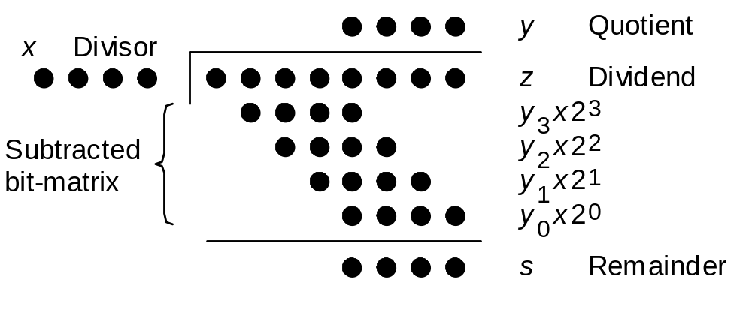
11.4 Shift-Subtract Division
Figure11.9 Division of an 8-bit number by a 4-bit number in dot notation.
z^{(j)} = 2z^{(j−1)} − y_{k−j} x 2^{k} with z⁽⁰⁾ = z and z^{(k)} = 2^{k} s
| shift |
|–– subtract ––|
Oct. 2014
Computer Architecture, The Arithmetic/Logic Unit
Slide <number>

Slide 65
Integer and Fractional Unsigned Division
Example 11.5
Position 7 6 5 4 3 2 1 0 Position –1 –2 –3 –4 –5 –6 –7 –8
========================= ==========================
z 0 1 1 1 0 1 0 1 z . 1 4 3 5 1 5 0 2
x2⁴ 1 0 1 0 x . 4 0 6 7
========================= ==========================
z ⁽⁰⁾ 0 1 1 1 0 1 0 1 z ⁽⁰⁾ . 1 4 3 5 1 5 0 2
2z ⁽⁰⁾ 0 1 1 1 0 1 0 1 10z ⁽⁰⁾ 1 . 4 3 5 1 5 0 2
–y₃x2⁴ 1 0 1 0 y₃=1 –y_{–1}x 1 . 2 2 0 1 y_{–1}=3
–––––––––––––––––––––––––– –––––––––––––––––––––––––––
z ⁽¹⁾ 0 1 0 0 1 0 1 z ⁽¹⁾ . 2 1 5 0 5 0 2
2z ⁽¹⁾ 0 1 0 0 1 0 1 10z ⁽¹⁾ 2 . 1 5 0 5 0 2
–y₂x2⁴ 0 0 0 0 y₂=0 –y_{–2}x 2 . 0 3 3 5 y_{–2}=5
–––––––––––––––––––––––––– –––––––––––––––––––––––––––
z ⁽²⁾ 1 0 0 1 0 1 z ⁽²⁾ . 1 1 7 0 0 2
2z ⁽²⁾ 1 0 0 1 0 1 10z ⁽²⁾ 1 . 1 7 0 0 2
–y₁x2⁴ 1 0 1 0 y₁=1 –y_{–3}x 0 . 8 1 3 4 y_{–3}=2
–––––––––––––––––––––––––– –––––––––––––––––––––––––––
z ⁽³⁾ 1 0 0 0 1 z ⁽³⁾ . 3 5 6 6 2
2z ⁽³⁾ 1 0 0 0 1 10z ⁽³⁾ 3 . 5 6 6 2
–y₀x2⁴ 1 0 1 0 y₀=1 –y_{–4}x 3 . 2 5 3 6 y_{–4}=8
–––––––––––––––––––––––––– –––––––––––––––––––––––––––
z ⁽⁴⁾ 0 1 1 1 z ⁽⁴⁾ . 3 1 2 6
s 0 1 1 1 s . 0 0 0 0 3 1 2 6
y 1 0 1 1 y . 3 5 2 8
========================= ==========================
Figure 11.10 Division examples for binary integers and decimal fractions.
Oct. 2014
Computer Architecture, The Arithmetic/Logic Unit
Slide <number>

Slide 66
Division with Same-Width Operands
Example 11.6
Position 7 6 5 4 3 2 1 0 Position –1 –2 –3 –4 –5 –6 –7 –8
========================= ==========================
z 0 0 0 0 1 1 0 1 z . 0 1 0 1
x2⁴ 0 1 0 1 x . 1 1 0 1
========================= ==========================
z ⁽⁰⁾ 0 0 0 0 1 1 0 1 z ⁽⁰⁾ . 0 1 0 1
2z ⁽⁰⁾ 0 0 0 1 1 0 1 2z ⁽⁰⁾ 0 . 1 0 1 0
–y₃x2⁴ 0 0 0 0 y₃=0 –y_{–1}x 0 . 0 0 0 0 y_{–1}=0
–––––––––––––––––––––––––– –––––––––––––––––––––––––––
z ⁽¹⁾ 0 0 0 1 1 0 1 z ⁽¹⁾ . 1 0 1 0
2z ⁽¹⁾ 0 0 1 1 0 1 2z ⁽¹⁾ 1 . 0 1 0 0
–y₂x2⁴ 0 0 0 0 y₂=0 –y_{–2}x 0 . 1 1 0 1 y_{–2}=1
–––––––––––––––––––––––––– –––––––––––––––––––––––––––
z ⁽²⁾ 0 0 1 1 0 1 z ⁽²⁾ . 0 1 1 1
2z ⁽²⁾ 0 1 1 0 1 2z ⁽²⁾ 0 . 1 1 1 0
–y₁x2⁴ 0 1 0 1 y₁=1 –y_{–3}x 0 . 1 1 0 1 y_{–3}=1
–––––––––––––––––––––––––– –––––––––––––––––––––––––––
z ⁽³⁾ 0 0 0 1 1 z ⁽³⁾ . 0 0 0 1
2z ⁽³⁾ 0 0 1 1 2z ⁽³⁾ 0 . 0 0 1 0
–y₀x2⁴ 1 0 1 0 y₀=0 –y_{–4}x 0 . 0 0 0 0 y_{–4}=0
–––––––––––––––––––––––––– –––––––––––––––––––––––––––
z ⁽⁴⁾ 0 0 1 1 z ⁽⁴⁾ . 0 0 1 0
s 0 0 1 1 s . 0 0 0 0 0 0 1 0
y 0 0 1 0 y . 0 1 1 0
========================= ==========================
Figure 11.11 Division examples for 4/4-digit binary integers and fractions.
Oct. 2014
Computer Architecture, The Arithmetic/Logic Unit
Slide <number>

Slide 67
Signed Division
Method 1 (indirect): strip operand signs, divide, set result signs
Dividend Divisor Quotient Remainder
z = 5 x = 3 ⇒ y = 1 s = 2
z = 5 x = –3 ⇒ y = –1 s = 2
z = –5 x = 3 ⇒ y = –1 s = –2
z = –5 x = –3 ⇒ y = 1 s = –2
Method 2 (direct 2’s complement): develop quotient with digits
–1 and 1, chosen based on signs, convert to digits 0 and 1
Restoring division: perform trial subtraction, choose 0 for q digit
if partial remainder negative
Nonrestoring division: if sign of partial remainder is correct,
then subtract (choose 1 for q digit) else add (choose –1)
Oct. 2014
Computer Architecture, The Arithmetic/Logic Unit
Slide <number>

Slide 68
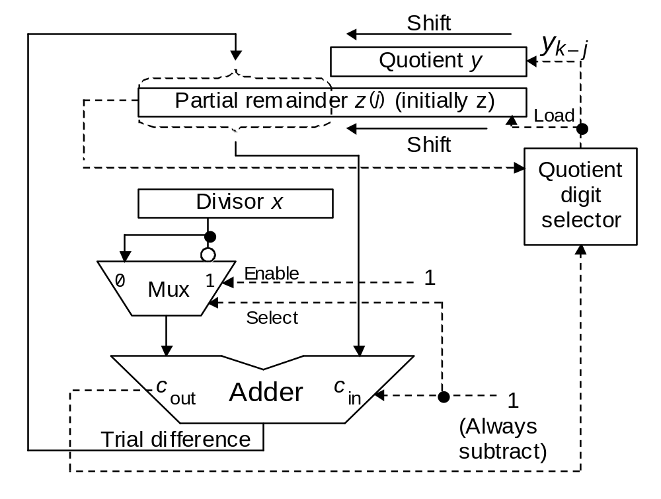
11.5 Hardware Dividers
Hi
Lo
Figure 11.12 Hardware divider based on the shift-subtract algorithm.
Oct. 2014
Computer Architecture, The Arithmetic/Logic Unit
Slide <number>

Slide 69
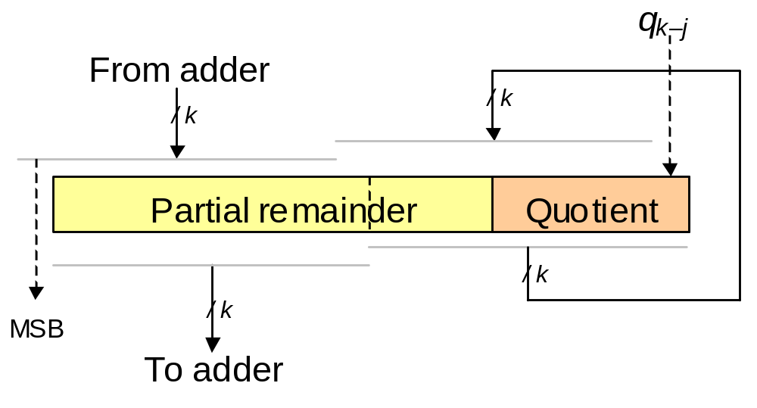
The Shift Part of Shift-Subtract
Figure 11.13 Shifting incorporated in the connections to the partial remainder register rather than as a separate phase.
Oct. 2014
Computer Architecture, The Arithmetic/Logic Unit
Slide <number>

Slide 70
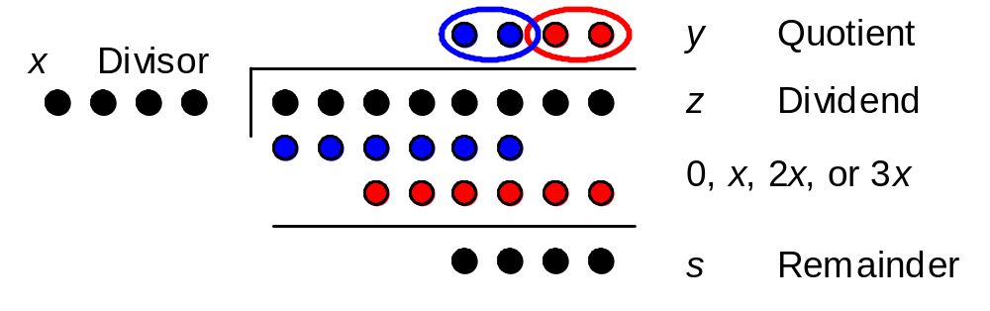
High-Radix Dividers
Radix-4 division in dot notation.
z^{(j)} = 4z^{(j−1)} − (y_{k−2j+1} y_{k−2j})_{two} x 2^{k} with z⁽⁰⁾ = z and z^{(k/2)} = 2^{k}s
| shift |
|––––––– subtract –––––––|
Assume k even
Oct. 2014
Computer Architecture, The Arithmetic/Logic Unit
Slide <number>

Slide 71
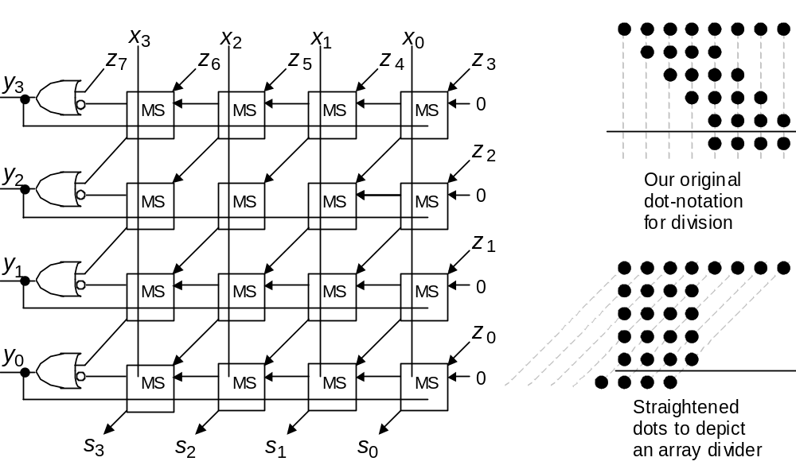
Array Dividers
b
d
Figure 11.14 Array divider for 8/4-bit unsigned integers.
Oct. 2014
Computer Architecture, The Arithmetic/Logic Unit
Slide <number>

Slide 72
11.6 Programmed Division
MiniMIPS instructions related to division
div $s0,$s1 # Lo = quotient, Hi = remainder
divu $s2,$s3 # unsigned version of division
mfhi $t0 # set $t0 to (Hi)
mflo $t1 # set $t1 to (Lo)
Example 11.7
Compute z mod x, where z (singed) and x > 0 are integers
Divide; remainder will be obtained in Hi
if remainder is negative,
then add |x| to (Hi) to obtain z mod x
else Hi holds z mod x
Oct. 2014
Computer Architecture, The Arithmetic/Logic Unit
Slide <number>

Slide 73
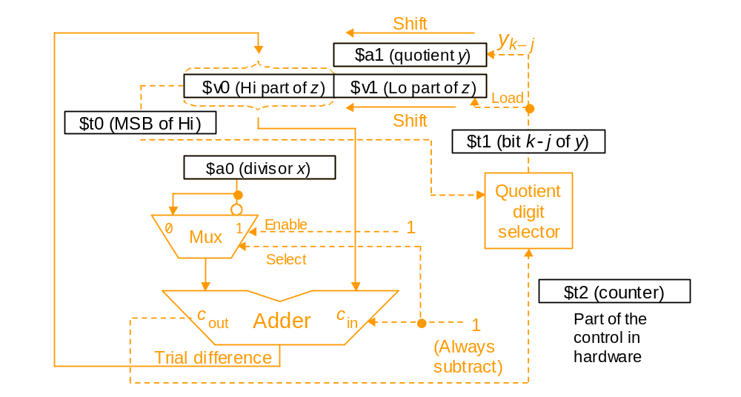
Emulating a Hardware Divider in Software
Example 11.8 (MiniMIPS shift-add program for division)
Figure 11.15 Register usage for programmed division superimposed on the block diagram for a hardware divider.
Oct. 2014
Computer Architecture, The Arithmetic/Logic Unit
Slide <number>

Slide 74
Division When There Is No Divide Instruction
Example 11.7 (MiniMIPS shift-subtract program for division)
shsdi: move $v0,$a2 # initialize Hi to ($a2)
move $vl,$a3 # initialize Lo to ($a3)
addi $t2,$zero,32 # initialize repetition counter to 32
dloop: slt $t0,$v0,$zero # copy MSB of Hi into $t0
sll $v0,$v0,1 # left-shift the Hi part of z
slt $t1,$v1,$zero # copy MSB of Lo into $t1
or $v0,$v0,$t1 # move MSB of Lo into LSB of Hi
sll $v1,$v1,1 # left-shift the Lo part of z
sge $t1,$v0,$a0 # quotient digit is 1 if (Hi) ≥ x,
or $t1,$t1,$t0 # or if MSB of Hi was 1 before shifting
sll $a1,$a1,1 # shift y to make room for new digit
or $a1,$a1,$t1 # copy y[k-j] into LSB of $a1
beq $t1,$zero,nosub # if y[k-j] = 0, do not subtract
subu $v0,$v0,$a0 # subtract divisor x from Hi part of z
nosub: addi $t2,$t2,-1 # decrement repetition counter by 1
bne $t2,$zero,dloop # if counter > 0, repeat divide loop
move $v1,$a1 # copy the quotient y into $v1
jr $ra # return to the calling program
Oct. 2014
Computer Architecture, The Arithmetic/Logic Unit
Slide <number>

Slide 75
Divider vs Multiplier: Hardware Similarities
Figure 11.12
Figure 11.4
Figure 11.14
Turn upside-down
Figure 11.7
Oct. 2014
Computer Architecture, The Arithmetic/Logic Unit
Slide <number>

Slide 76
12 Floating-Point Arithmetic
Floating-point is no longer reserved for high-end machines
  Multimedia and signal processing require flp arithmetic
  Details of standard flp format and arithmetic operations
Topics in This Chapter
12.1 Rounding Modes
12.2 Special Values and Exceptions
12.3 Floating-Point Addition
12.4 Other Floating-Point Operations
12.5 Floating-Point Instructions
12.6 Result Precision and Errors
Oct. 2014
Computer Architecture, The Arithmetic/Logic Unit
Slide <number>

Slide 77
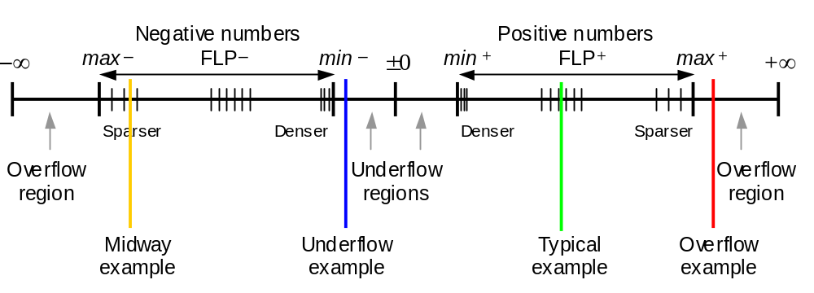
12.1 Rounding Modes
IEEE 754
Format
±0, ±∞, NaN
1.f × 2e
Denormals:
0.f × 2^{emin}
Denormals allow graceful underflow
Figure 12.1 Distribution of floating-point numbers on the real line.
Oct. 2014
Computer Architecture, The Arithmetic/Logic Unit
Slide <number>

Slide 78
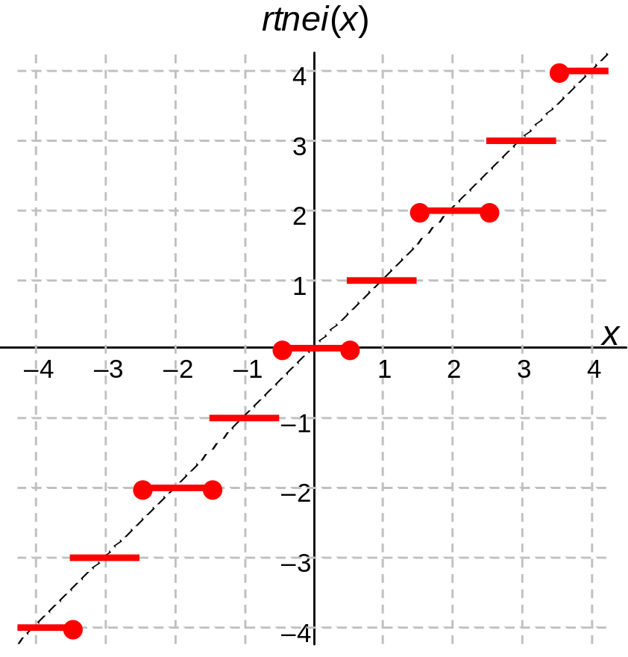

Round-to-Nearest (Even)
(a) Round to nearest even integer (b) Round to nearest integer
Figure 12.2 Two round-to-nearest-integer functions for x in [–4, 4].
Oct. 2014
Computer Architecture, The Arithmetic/Logic Unit
Slide <number>

Slide 79


Directed Rounding
(a) Round inward to nearest integer (b) Round upward to nearest integer
Figure 12.3 Two directed round-to-nearest-integer functions for x in [–4, 4].
Oct. 2014
Computer Architecture, The Arithmetic/Logic Unit
Slide <number>

Slide 80
12.2 Special Values and Exceptions
Zeros, infinities, and NaNs (not a number)
± 0 Biased exponent = 0, significand = 0 (no hidden 1)
± ∞Biased exponent = 255 (short) or 2047 (long), significand = 0
NaN Biased exponent = 255 (short) or 2047 (long), significand ≠ 0
Arithmetic operations with special operands
(+0) + (+0) = (+0) – (–0) = +0
(+0) × (+5) = +0
(+0) / (–5) = –0
(+∞) + (+∞) = +∞
x – (+∞) = –∞
(+∞) × x = ±∞, depending on the sign of x
x / (+∞) = ±0, depending on the sign of x
√(+∞) = +∞
Oct. 2014
Computer Architecture, The Arithmetic/Logic Unit
Slide <number>

Slide 81
Exceptions
Undefined results lead to NaN (not a number)
(±0) / (±0) = NaN
(+∞) + (–∞) = NaN
(±0) × (±∞) = NaN
(±∞) / (±∞) = NaN
Arithmetic operations and comparisons with NaNs
NaN + x = NaN NaN < 2 → false
NaN + NaN = NaN NaN = Nan → false
NaN × 0 = NaN NaN ≠ (+∞) → true
NaN × NaN = NaN NaN ≠ NaN → true
Examples of invalid-operation exceptions
Addition: (+∞) + (–∞)
Multiplication: 0 × ∞
Division: 0 / 0 or ∞ / ∞
Square-root: Operand < 0
Oct. 2014
Computer Architecture, The Arithmetic/Logic Unit
Slide <number>

Slide 82

12.3 Floating-Point Addition
(±2^{e1}s1)
+ (±2^{e1}(s2 / 2^{e1–e2})) = ±2^{e1}(s1 ± s2 / 2^{e1–e2})
(±2^{e2}s2)
Figure 12.4 Alignment shift and rounding in floating-point addition.
Oct. 2014
Computer Architecture, The Arithmetic/Logic Unit
Slide <number>

Slide 83

Hardware for Floating-Point Addition
Figure 12.5
Simplified schematic of a floating-point adder.
Oct. 2014
Computer Architecture, The Arithmetic/Logic Unit
Slide <number>

Slide 84
12.4 Other Floating-Point Operations
Floating-point multiplication
(±2^{e1}s1) × (±2^{e2}s2) = ±2^{e1+ e2}(s1 × s2)
Product of significands in [1, 4)
If product is in [2, 4), halve to normalize (increment exponent)
Floating-point division
(±2^{e1}s1) / (±2^{e2}s2) = ±2^{e1– e2}(s1 / s2)
Ratio of significands in (1/2, 2)
If ratio is in (1/2, 1), double to normalize (decrement exponent)
Floating-point square-rooting
(2es)^{1/2} = 2^{e/2}(s)^{1/2} when e is even
= 2^{(e–1)2}(2s)^{1/2} when e is odd
Normalization not needed
Overflow (underflow) possible
Overflow (underflow) possible
Oct. 2014
Computer Architecture, The Arithmetic/Logic Unit
Slide <number>

Slide 85

Hardware for Floating-Point Multiplication and Division
Figure 12.6 Simplified schematic of a floating-point multiply/divide unit.
Oct. 2014
Computer Architecture, The Arithmetic/Logic Unit
Slide <number>

Slide 86

12.5 Floating-Point Instructions
Floating-point arithmetic instructions for MiniMIPS:
add.s $f0,$f8,$f10 # set $f0 to ($f8) +_{fp} ($f10)
sub.d $f0,$f8,$f10 # set $f0 to ($f8) –_{fp} ($f10)
mul.d $f0,$f8,$f10 # set $f0 to ($f8) ×_{fp} ($f10)
div.s $f0,$f8,$f10 # set $f0 to ($f8) /_{fp} ($f10)
neg.s $f0,$f8 # set $f0 to –($f8)
Figure 12.7 The common floating-point instruction format for MiniMIPS and components for arithmetic instructions. The extension (ex) field distinguishes single (* = s) from double (* = d) operands.
Oct. 2014
Computer Architecture, The Arithmetic/Logic Unit
Slide <number>

Slide 87

The Floating-Point Unit in MiniMIPS
Coprocessor 1
Pairs of registers, beginning with an even-numbered one, are used for double operands
Figure 5.1 Memory and processing subsystems for MiniMIPS.
Oct. 2014
Computer Architecture, The Arithmetic/Logic Unit
Slide <number>

Slide 88

Floating-Point Format Conversions
MiniMIPS instructions for number format conversion:
cvt.s.w $f0,$f8 # set $f0 to single(integer $f8)
cvt.d.w $f0,$f8 # set $f0 to double(integer $f8)
cvt.d.s $f0,$f8 # set $f0 to double($f8)
cvt.s.d $f0,$f8 # set $f0 to single($f8,$f9)
cvt.w.s $f0,$f8 # set $f0 to integer($f8)
cvt.w.d $f0,$f8 # set $f0 to integer($f8,$f9)
Figure 12.8 Floating-point instructions for format conversion in MiniMIPS.
Oct. 2014
Computer Architecture, The Arithmetic/Logic Unit
Slide <number>

Slide 89


Floating-Point Data Transfers
MiniMIPS instructions for floating-point load, store, and move:
lwc1 $f8,40($s3) # load mem[40+($s3)] into $f8
swc1 $f8,A($s3) # store ($f8) into mem[A+($s3)]
mov.s $f0,$f8 # load $f0 with ($f8)
mov.d $f0,$f8 # load $f0,$f1 with ($f8,$f9)
mfc1 $t0,$f12 # load $t0 with ($f12)
mtc1 $f8,$t4 # load $f8 with ($t4)
Figure 12.9 Instructions for floating-point data movement in MiniMIPS.
Oct. 2014
Computer Architecture, The Arithmetic/Logic Unit
Slide <number>

Slide 90


Floating-Point Branches and Comparisons
MiniMIPS instructions for floating-point load, store, and move:
bc1t L # branch on fp flag true
bc1f L # branch on fp flag false
c.eq.* $f0,$f8 # if ($f0)=($f8), set flag to “true”
c.lt.* $f0,$f8 # if ($f0)<($f8), set flag to “true”
c.le.* $f0,$f8 # if ($f0)≤($f8), set flag to “true”
Correction: 1 1 x x x 0
Figure 12.10 Floating-point branch and comparison instructions in MiniMIPS.
Oct. 2014
Computer Architecture, The Arithmetic/Logic Unit
Slide <number>

Slide 91
Floating-Point Instructions of MiniMIPS
Instruction | Usage
Move s/d registers | mov.* fd,fs
Move fm coprocessor 1 | mfc1 rt,rd
Move to coprocessor 1 | mtc1 rd,rt
Add single/double | add.* fd,fs,ft
Subtract single/double | sub.* fd,fs,ft
Multiply single/double | mul.* fd,fs,ft
Divide single/double | div.* fd,fs,ft
Negate single/double | neg.* fd,fs
Compare equal s/d | c.eq.* fs,ft
Compare less s/d | c.lt.* fs,ft
Compare less or eq s/d | c.le.* fs,ft
Convert integer to single | cvt.s.w fd,fs
Convert integer to double | cvt.d.w fd,fs
Convert single to double | cvt.d.s fd,fs
Convert double to single | cvt.s.d fd,fs
Convert single to integer | cvt.w.s fd,fs
Convert double to integer | cvt.w.d fd,fs
Load word coprocessor 1 | lwc1 ft,imm(rs)
Store word coprocessor 1 | swc1 ft,imm(rs)
Branch coproc 1 true | bc1t L
Branch coproc 1 false | bc1f L
ex
#
0
4
#
#
#
#
#
#
#
#
0
0
1
1
0
1
rs
rs
8
8
fn
6
0
1
2
3
7
50
60
62
32
33
33
32
36
36
Copy
Table 12.1
Arithmetic
* s/d for single/double
# 0/1 for single/double
Conversions
Memory access
Control transfer
Oct. 2014
Computer Architecture, The Arithmetic/Logic Unit
Slide <number>

Slide 92


12.6 Result Precision and Errors
Example 12.4
Laws of algebra may not hold in floating-point arithmetic. For example,
the following computations show that the associative law of addition,
(a + b) + c = a + (b + c), is violated for the three numbers shown.
Oct. 2014
Computer Architecture, The Arithmetic/Logic Unit
Slide <number>

Slide 93
Error Control and Certifiable Arithmetic
Catastrophic cancellation in subtracting almost equal numbers:
Area of a needlelike triangle
A = [s(s – a)(s – b)(s – c)]^{1/2}
Possible remedies
Carry extra precision in intermediate results (guard digits): commonly used in calculators
Use alternate formula that does not produce cancellation errors
Certifiable arithmetic with intervals
A number is represented by its lower and upper bounds [x_{l}, x_{u}]
Example of arithmetic: [x_{l}, x_{u}] +_{interval} [y_{l}, y_{u}] = [x_{l} +_{fp∇} y_{l}, x_{u} +_{fpΔ} y_{u}]
c
b
a
Oct. 2014
Computer Architecture, The Arithmetic/Logic Unit
Slide <number>

Slide 94
Evaluation of Elementary Functions
Approximating polynomials
ln x = 2(z + z³/3 + z⁵/5 + z⁷/7 + . . . ) where z = (x – 1)/(x + 1)
e^{x} = 1 + x/1! + x²/2! + x³/3! + x⁴/4! + . . .
cos x = 1 – x²/2! + x⁴/4! – x⁶/6! + x⁸/8! – . . .
tan^{–1} x = x – x³/3 + x⁵/5 – x⁷/7 + x⁹/9 – . . .
Iterative (convergence) schemes
For example, beginning with an estimate for x^{1/2}, the following iterative formula provides a more accurate estimate in each step
q^{(i+1)} = 0.5(q^{(i)} + x/q^{(i)})
Table lookup (with interpolation)
A pure table lookup scheme results in huge tables (impractical); hence, often a hybrid approach, involving interpolation, is used.
Oct. 2014
Computer Architecture, The Arithmetic/Logic Unit
Slide <number>

Slide 95

Function Evaluation by Table Lookup
Figure 12.12 Function evaluation by table lookup and linear interpolation.
Oct. 2014
Computer Architecture, The Arithmetic/Logic Unit
Slide <number>

